Slide 1
Developmental Centered Parenting
Parents as Teachers
Notes:
Good morning!
We’re excited to have this time to review the “Developmental Centered Parenting” portion of the PAT Home Visit…

Slide 2
Agenda
The Why
7 Developmental Topics
Break out & Discussion
InTentionS & ReSources
Notes:
Here’s a plan for today, similar to the other PAT sessions this week.

Slide 3
Notes:
Here’s the PAT Personal Observation Tool (our self check we’re delivering the curriculum to fidelity).
WHY is this important/part of PAT?
Child developmental progress is continually influenced by choices parents make which are based on their: current knowledge, parenting experiences, cultural values
--Link to PAT Activity Sheets: Reflective questions on the back are designed to draw out
-Link to PARENTING BEHAVIORS)
Ex: Designing/guiding – appears throughout the SAFETY Topic of having a safe & enriching home environment for exploring based on the child’s age/stage
Revisiting these topics frequently:
increases parent confidence as they can be more prepared
Decreases risk of child abuse & neglect
Many parents lack a clear understanding of WHEN young children are capable of reaching developmental milestones (examples: potty training, controlling emotions)
*Social/emotional milestones are less understood than physical or cognitive ones
“D.C.P. is when parents UNDERSTAND and OBSERVE their child’s progress and ADAPT their parenting behaviors to meet their child’s need based on his stage of development. – REVISIT FREQUENTLY as needs/expectations change with stage

Slide 4
Developmental Topics
Attachment
Discipline
Health: Well Child & Dental
Nutrition
Safety
sLEEP
Transitions and routines
Notes:
Attachment: Prenatal Attachment & Secure Attachment
Discipline: Positive approaches (strength based, Cons. Discp); Temper Tantrums
Health
Medical & Dental Homes, WCCs, H & V, Follow up
Mental Health
Physical Fitness/Activity/BMI
Nutrition :Breastfeeding, Starting Solids, Weaning, Healthy Diets (BMI)
Safety:
Home Environment, Outside (Safe Enviro Checklist); Neurotoxins
Child Abuse & Neglect prevention
Sleep: SIDS Prevention, Safe Sleep
Transitions/Routines
Pregnancy/Prenatal Care and Nutrition/Health Births
Temperament
Toilet Learning
Healthy Births

Slide 5
Share Strategies for Success with Dev.Centered ParenTing
15-minute breakout

Slide 6
Notes:
REBECCA: Screen Share PAT Site and P.E. Resource – PG. 1132

Slide 7
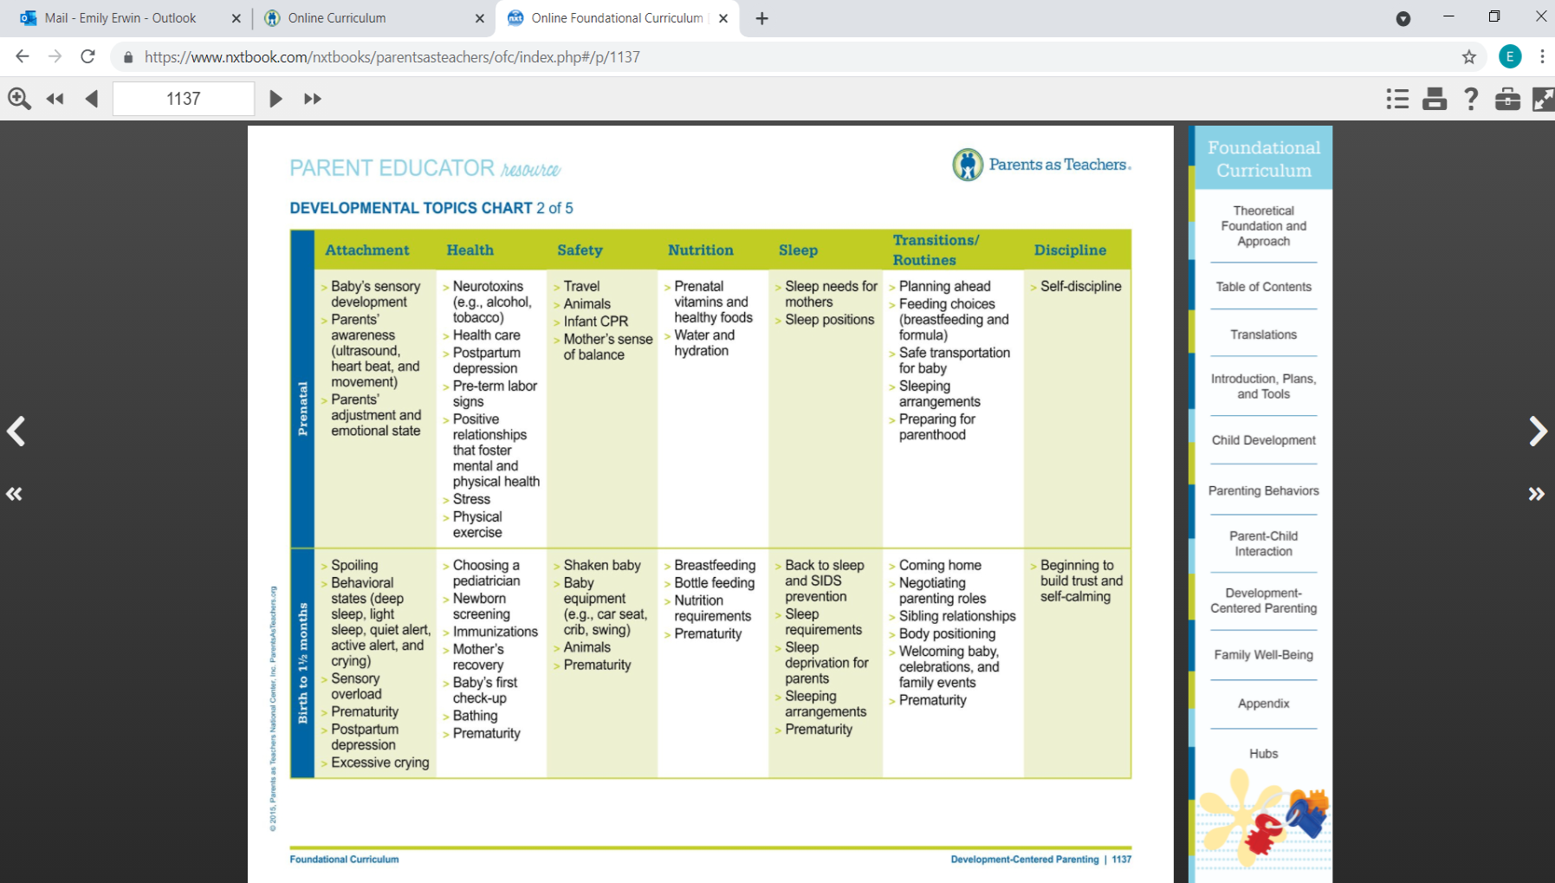
Notes:
REBECCA: Show PAT Site Pg. 1137

Slide 8
What Will YOU DO TO Be More IntentionAL?
15-minute breakout

Slide 9
PAT Personal Visit Observation PAT Resources
P.E. Resource “Theoretical Foundations Guiding Parents as Teachers” intro pgs 1-2
P.E. Resource “Developmental Topics” pg. 1132-1135
P.E Resource “Developmental Topics Chart pg. 1137-1140
Foundational Visits #3 and #4
P.H. “Parenting Around Development” pg.1141
Toolkit Cards 9-16: Developmental Topics
PAT Milestones
See also: Parenting Behaviors Resources

Slide 10
Thank You

