Slide 1
Head Start and Early Head Start Recruitment, Selection and Enrollment Priorities
For Policy Council and Governing Board

Slide 2

HSPPS 1302.12 (m)
Training on Eligibility
A program must train all governing body, policy council, management, and staff who determine eligibility on applicable federal regulations and program policies and procedures. (3) A program must training all governing body and policy council members within 180 days of the beginning term.
Methods on how to collect complete and accurate eligibility information
Early Head Start and Head Start Enrollment Priority Criteria
Treating families with dignity and respect
Program policy on falsifying information

Slide 3

What makes a family eligible?
The family’s income is equal to or below the 100% Federal Poverty Level
The family is homeless
The child is in foster/kinship care
The family is currently receiving Supplemental Security Income (SSI) or Family Impendence Program (FIP)
Additional allowances may be given to enroll a child over the 100% Federal Poverty Level.

Slide 4

How do we determine if a family is eligible?
Copies of supporting documents or written consent for income, McKinney Vento homeless determination, Foster/Kinship Care from CPS, SSI determinations, FIP cash assistance from DHHS.
All copies must be attached to the application
Families with no income or unable to prove income can provide a written declaration of their eligibility. As a response to this written declaration, staff must make efforts to verify the family’s eligibility and describe the family’s living situation.
Staff use a Family Income Status/Staff Documentation form and a Third Party Documentation form to streamline the verification process.

Slide 5
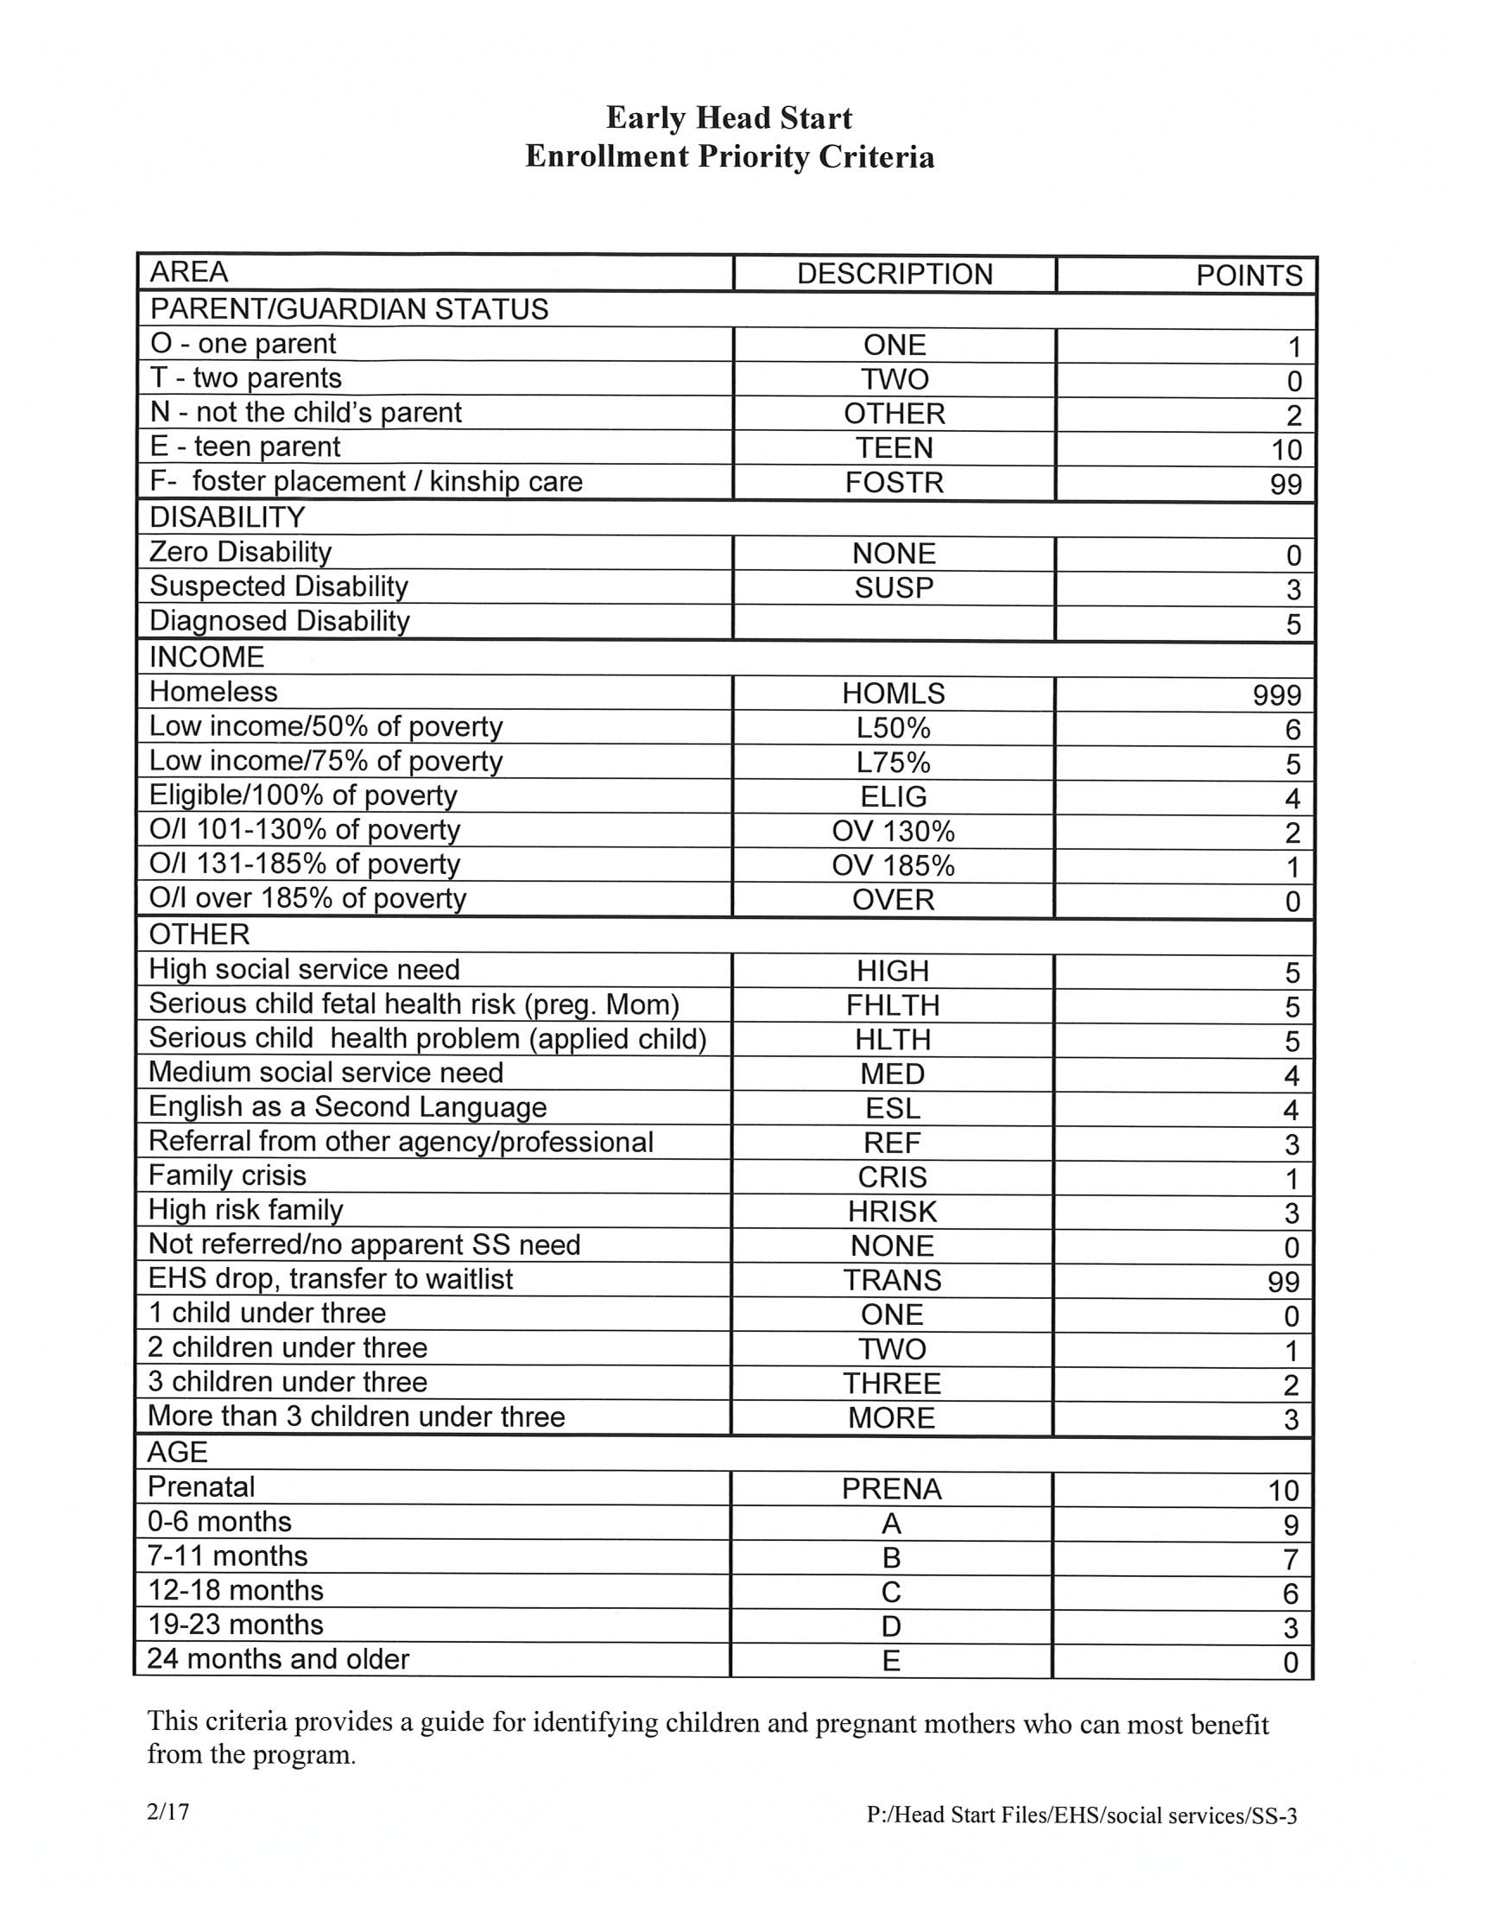
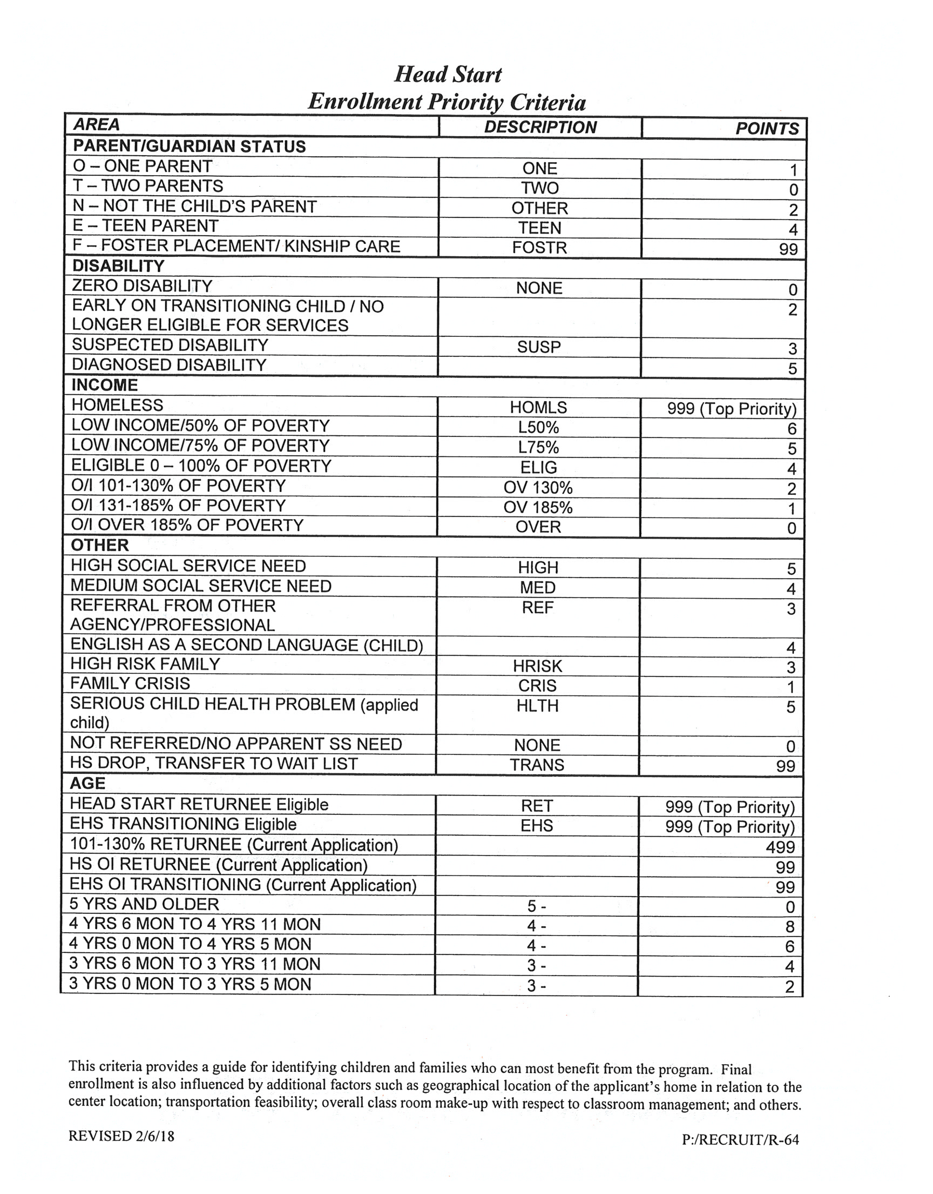
EHS and HS Enrollment Priority Criteria

Slide 6

Treating Families with Dignity and Respect
NMCAA Cornerstones of Culture is a guiding document that represents the collective vision of the organizational culture of NMCAA.
NMCAA’s Cornerstones of Culture outlines key principals of a positive and health work environment and helps to ensure that these standards are always at the center of our interactions with each other and our families.

Slide 7
Disciplinary Action for Falsifying Information
NMCAA Personnel Policies state that staff who are dishonest (intentionally violate eligibility rules) are subject to disciplinary action, up to and including termination without prior warning or attempt at corrective discipline.
As stated on the Early Childhood Programs of Northwest Michigan Client Intake, applicants certify that the information on the application is true. If any part is false, it is acknowledge that the applicant’s participation in the agency’s program may be terminated and they may be
The EHS and HS Eligibility Verification form signed by the staff, states that knowingly falsifying documents and determining a child eligible for Head Start when the child does not meet the eligibility criteria can lead to criminal charges.

Slide 8

Spread the word!
There are many ways to help with recruiting families:
Share your story to family, friends and neighbors
Hang flyers in the community
Like Northwest Michigan Community Action Agency on Facebook and share our poster

