Slide 1
Welcome Slide

Slide 2
YJT – life is a journey – early experiences matter!
Purpose: Think about how young children are impacted throughout life by the early experiences provided by caregiving adults, setting the stage for discussion about resilience, protective factors, and risk factors in young children.
All children experience adversity and risk, and all children have positive experiences and characteristics. Research clearly informs us that brain development is the most rapid and vulnerable in the first three years of life. These experiences impact future development and life outcomes. REMINDER: positive experiences help children move towards hope, happiness and success!
Activity:
Look at the picture and talk about what you notice with an elbow partner.
Notice that the suitcase the little girl is carrying says “HOPE” – this signifies hope for a good future for our children, which most of us want for all children.
List the positive experiences this child may have experienced, next think about some negative experiences that might be in her suitcase.
Discussion: Today we looked at how experiences provided for children are important for their future, there might be challenges and adversities, but there is always hope for happiness and success. How might this effect the way we do our work?

Slide 3
Teaching Strategies Gold

Slide 4
Gold Objective and Dimensions
Areas of Development
Social-Emotional
Physical
Language
Cognitive
Literacy
Objectives
-Sub category under Areas of Development
- Ex: Objective 1 Regulates emotions and behaviors
Dimension
Guides teachers thinking about various aspect of an objective.
Not all objectives have dimensions
Example:
Objective 1 Regulates Emotions and Behaviors
Dimensions: a. Manages Feelings
b. follows limits and expectations.

Slide 5
Areas of Development & Learning → Literacy
Objective →
Dimension →
Rating scale →
Indicator →
(in bold)
Examples →
Expectations for ages→

Slide 6
Gold expectations
At a minimum, an observation should be entered once a month in each Area of Development per child (Social-Emotional, Physical, Language, Cognitive, Literacy)
The more observations documented, the more accurate the data
If a child is dropped mid-quarter, talk with your PSC about whether the dropped child, added child, or both children will have finalized checkpoints. There will be a minimum of 5 finalized checkpoints for part-time staff and a minimum of 10 finalized checkpoints for full-time staff unless otherwise approved by your PSC
When adding a child to GOLD that has an IFSP, Yes will be marked when asked if the child has an IFSP. If a child obtains an IFSP while we serve them, their profile will be edited to show they have an IFSP in GOLD.

Slide 7
School Readiness GOLD data
 | % of indicators below expectations |  |  |  | % of indicators at/above expectations
Date | 11/30 | 2/28 | 5/31 | 8/31 | 11/30 | 2/28 | 5/31 | 8/31
Social-Emotional | 12 | 11 | 5 | 10 | 88 | 89 | 95 | 90
Perceptual, Motor, Physical | 10 | 6 | 2 | 5 | 90 | 94 | 98 | 95
Approaches to Learning | 7 | 5 | 2 | 7 | 93 | 95 | 98 | 93
Cognitive | 7 | 5 | 3 | 5 | 93 | 95 | 97 | 95
Communication, Language and Literacy | 18 | 12 | 8 | 13 | 82 | 88 | 92 | 87

Slide 8
School Readiness Focus area (2018-19)
Meeting/Exceeding
 | Fall | Winter | Spring | Summer
Approaches to Learning: 11c -Solves Problems Birth-1 1-2 years 2-3 years | 95% 100% 100% 89% | 95% 100% 100% 90% | 96% 100% 100% 92% | 94% 100% 99% 93%
Cognitive: 12b – Makes Connections Birth-1 year 1-2 years 2-3 years | 100% 100% 100% 99% | 98% 100% 99% 97% | 100% 100% 100% 99% | 99% 100% 99% 99%
Perceptual, Motor, Physical 7a – Uses Fingers and Hands Birth – 1 year 1-2 years 2-3 years | 92% 97% 91% 92% | 97% 100% 96% 97% | 96% 100% 96% 96% | 92% 100% 91% 95%
Social-Emotional 1c – Takes Care of Own Needs Appropriately Birth-1 year 1-2 years 2-3 years | 90% 94% 86% 94% | 91% 100% 90% 90% | 94% 100% 92% 94% | 91% 96% 89% 94%
Communication, Language, Literacy 10a – Engages in Conversation Birth-1 year 1-2 years 2-3 years | 82% 79% 95% 70% | 85% 69% 99% 80% | 89% 89% 95% 85% | 81% 89% 91% 76%

Slide 9
School readiness
How is GOLD connected?
Aligns with the Early Learning Outcomes Framework (ELOF), which is the foundation for school readiness
The more observations, the more accurate our data, supporting PD across our program
Supports individualizing for each child/family

Slide 10
Health & Insurance Information

Slide 11
1302.42 Child health status and care
(i) Obtain determinations from health care and oral health care professionals as to whether or not the child is up-to-date on a schedule of age appropriate preventive and primary medical and oral health care, based on: the well-child visits and dental periodicity schedules as prescribed by the Early and Periodic Screening, Diagnosis, and Treatment (EPSDT) program of the Medicaid agency of the state in which they operate, immunization recommendations issued by the Centers for Disease Control and Prevention, and any additional recommendations from the local Health Services Advisory Committee that are based on prevalent community health problems;
(ii) Assist parents with making arrangements to bring the child up-to-date as quickly as possible; and, if necessary, directly facilitate provision of health services to bring the child up-to-date with parent consent as described in §1302.41(b)(1).
(2) Within 45 calendar days after the child first attends the program or, for the home-based program option, receives a home visit, a program must either obtain or perform evidence-based vision and hearing screenings.
(3) If a program operates for 90 days or less, it has 30 days from the date the child first attends the program to satisfy paragraphs (b)(1) and (2) of this section.

Slide 12
1302.42 Child health status and care. Continued
(c) Ongoing care. (1) A program must help parents continue to follow recommended schedules of well-child and oral health care.
(2) A program must implement periodic observations or other appropriate strategies for program staff and parents to identify any new or recurring developmental, medical, oral, or mental health concerns.
(3) A program must facilitate and monitor necessary oral health preventive care, treatment and follow-up, including topical fluoride treatments. In communities where there is a lack of adequate fluoride available through the water supply and for every child with moderate to severe tooth decay, a program must also facilitate fluoride supplements, and other necessary preventive measures, and further oral health treatment as recommended by the oral health professional.
(d) Extended follow-up care. (1) A program must facilitate further diagnostic testing, evaluation, treatment, and follow-up plan, as appropriate, by a licensed or certified professional for each child with a health problem or developmental delay, such as elevated lead levels or abnormal hearing or vision results that may affect child’s development, learning, or behavior.

Slide 13
requirements
Health Status Determination Date
MIHP 2 week appointment
11 Well Child Checks (WCC)
12 and 24 month lead
12 month Hemoglobin
Yearly dental appointments
Hearing Screening
Vision Screening
Prenatal visits & Dental
Health History Form (completed at application)

Slide 14
What is a Well child Check

Slide 15
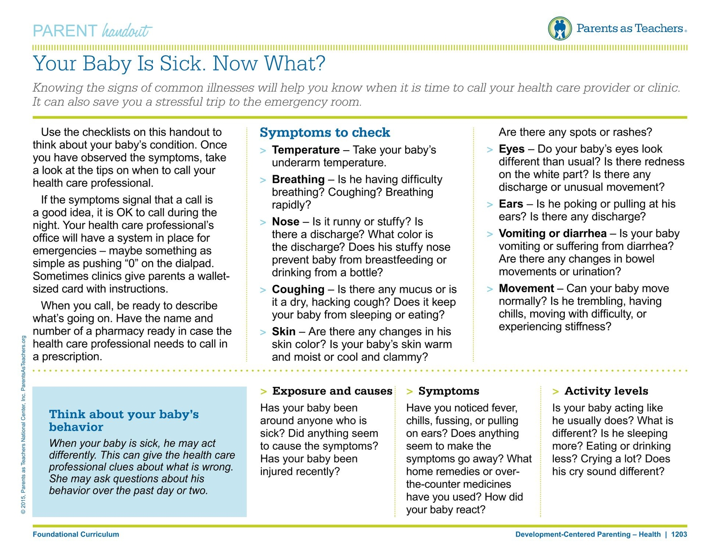
WCC VS other Doctors Appointments

Slide 16
CFS Role to ensure health is completed
At Enrollment
Explain all health requirements
Review health history
Review and update all disclosures & reason for disclosure section completion
Get last and next WCC dates
At Home visits
PAT 1193 & 1195 – parent educator resource
PAT 1199- Well Baby Checkup’s
Utilize the “What's Due When” chart
Ask and remind family of upcoming health appointments
Discuss and plan for challenges to completing health appointments
Remind families to schedule next wcc at current wcc
At home visit directly after wcc get date for next wcc
Ask families to call to set up during visits
May not be able to complete illness or new patient appointments at the same time as WCC
WIC appointments are only required for 12mo Lead & hmg and 24mo lead

Slide 17
R&H Role
At Application
Introduce Health Requirements
Identify Dental and Medical Homes
Complete health disclosures
Complete Health History
After Enrollment
Support CFS as needed to meet health requirements
Fax and document all required medical in Child Plus
Follow up and monitor health referrals
Build relationships with health providers and partners

Slide 18
PSC & Manager Roles
Ongoing monitoring of program requirements
Support CFS & R&H in reducing barriers to completing requirements

Slide 19
1302.46 Family support services for health, nutrition, and mental health
(2) A program must provide ongoing support to assist parents’ navigation through health systems to meet the general health and specifically identified needs of their children and must assist parents:
(i) In understanding how to access health insurance for themselves and their families, including information about private and public health insurance and designated enrollment periods;
(ii) In understanding the results of diagnostic and treatment procedures as well as plans for ongoing care; and,
(iii) In familiarizing their children with services they will receive while enrolled in the program and to enroll and participate in a system of ongoing family health care.

Slide 20
Insurance tips
Find out DHHS recertification date to help ensure successful process
Ask about insurance monthly
Michigan ENROLLS website https://healthcare4mi.com/MISelfService/resources/portal/index.html
Order new card, pick or change plan
MI Bridges website
https://newmibridges.michigan.gov/s/isd-landing-page?language=en_US
View Healthcare Benefit Information, Find a copy of the mihealth card, Search for providers
Refer to Health Department
Completing FOT
Medicaid open enrollment-varies by family
Talk with R & H when insurance is lost and reinstated

Slide 21
School readiness
How is Health connected?
Research-based, historical programs
Feeling good gives children the energy and strength to do the hard work
Early identification and treatment of developmental delays that would otherwise impede school readiness
Healthy children are ready to learn!

Slide 22
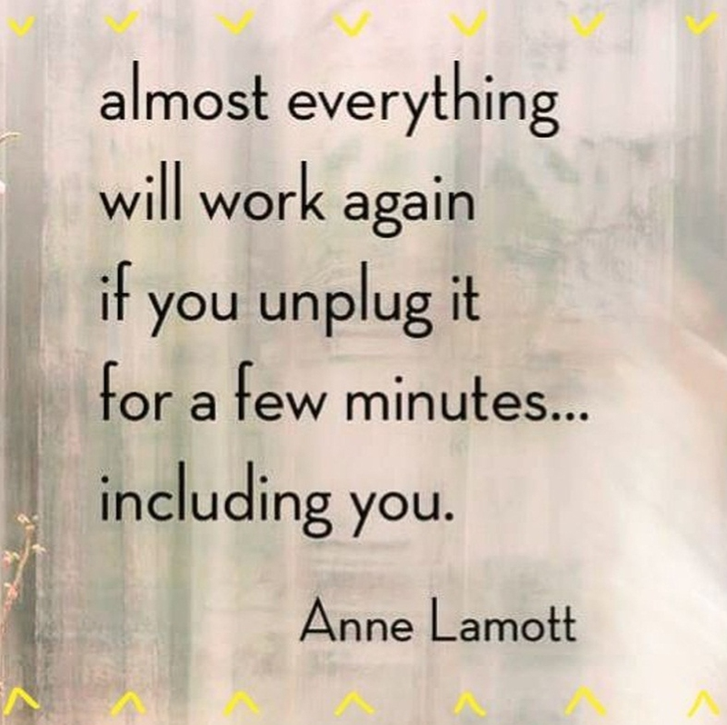

Slide 23
Parents as teachers
Personal Visit Observation Tool

Slide 24
Personal visit observation tool sections
Visit Preparation
PAT Personal Visit Elements
Across the Visit
Home Visit Process Quality

Slide 25
Visit preparation – What are the expectations?
PAT activity, intents and handouts at a minimum are listed – extension activities may be listed or may be decided at the hv; follow-up notes as reminders may also be
How did you choose this activity?
Check-in with the family is not mandatory.
Intents from the activity sheet are written down, ensuring child goal intent is also present.
2 points from the PE Resource you will share
Activity is age appropriate and connected to the child goal
The plan is individualized for this child and family.

Slide 26
PAT Personal visit elements
Opening:
CONNECT about something in the home, child(ren), or parent(s)
AGREE on what will happen in the visit from that was planned the week before, check in that this is what the family still wants to do
REFLECT with the parent(s) regarding their experience and their child’s experience with the extension activity (this will help with In Kind documentation!!)

Slide 27
PAT personal visit elements (continued)
Parent-Child Interaction
Parenting Behaviors Facilitated
Nurturing, Designing/Guiding, Responding, Communicating, Support Learning
(Point out, label and notice how 1 or more of the parenting behaviors impact the child’s development )
Child Development Domains Discussed – Language, Intellectual, Social-Emotional, Motor
Ask the parent what they observed their child doing, linking it to a parenting behavior
Share the intents for the activity
Facilitate the activity as a parent-child experience
Encourage the parent to join in by helping gather materials, asking them to join in, etc.

Slide 28
PAT Personal visit elements (continued)
Development-Centered Parenting
Sleep, Attachment, Discipline, Health, Transitions/Routines, Safety, Nutrition
Help the family connect their child’s behavior(s) to his or her stage of development
Family Well-Being
Get the family’s perspective on their own well-being, this might include personal resources, referrals made and information shared. If applicable, help the family access resources and follow-up on the status of accessing resources discussed previously, including challenges or barriers
Closing
REVIEW – restate key points about health or developmental topics
REVISIT – follow-up on next steps (extension activity)
EVALUATE – how do you think our visit
AFFIRM – share specific strengths you observed
Schedule the next visit, choose the focus with the family and plan the activity with materials

Slide 29
Across the visit
Did the visit incorporate the family’s language – may be N/A
The home visitor demonstrates respect for the family’s cultural background and parenting practices, including incorporating the family’s culture in the visit as appropriate (doing things/using language the family uses)
Reviewed handouts and connected to parent behavior(s) and/or activitie(s)
Family/child goals were established, discussed, reviewed and/or modified.
Literacy was incorporated into the visit (e.g., book sharing activity, giving book, encouraging family to engage with books beyond visit, etc.)
The home visitor partnered, facilitated and reflected with the family throughout the visit

Slide 30
After the visit
Home visit is completed and signed by the parent
Home visit is complete with extension activity included
Milestones are updated or completed – these are not mandatory

Slide 31
Home visit process quality
HOVRS (first 4 pages)
Home Visitor Response to Family
Home Visitor-Family Relationship
Home Visitor Facilitataion of Parent Child Interaction
Home Visitor Non-Intrusiveness/Collaboration with Family

Slide 32
Highlights and challenges
Highlights
Individualizing the plan
Appropriate handouts
Literacy is incorporated in every visit
Developmental topics discussed
Resources are shared along with follow-up
Home Visitor- Family Relationship
Challenges
Connecting from the last visit
Setting the agenda with the family
Sharing the intent for each area of emphasis with the family
Reviewing how the visit went, next steps (extension activities), and planning for the next visit
Connecting parenting behaviors

Slide 33
School readiness
How are observations connected?
School Readiness skills increase as we improve our practices as home visitors
Increased parent child connections support school readiness

Slide 34
Family Outcomes tool
Family Outcomes Tool Data is only collected once a year in the fall
Family Outcomes Tool Data is now “yes” or “no”
Home Practices and Routines will continue to be completed, in the Fall and Spring
Talking Points have changed with the Family Outcomes Tool to guide in conversation.
Many of the answers can be collected from page 1 and 2 of the intake – R & H have begun using the 2nd page of the intake, but not all of your families will have page 2 at this time. Answers that can be collected from the intake are noted in the Talking Points in red.
The FOT and Talking Points are on Weebly under Forms - Enrollment

Slide 35
Attendance
Month | 2017-18 | 2018-19
September | 73% | 74%
October | 89% | 89%
November | 68% | 74%
December | 54% | 60%
January | 85% | 71%
February | 67% | 70%
March | 70% | 75%
April | 86% | 81%
May | 76% | 85%
June | 81% | 76%
July | 77% | 70%
August | 60% | 79%
Average for the year | 74% | 75%

Slide 36
Health
 | Fall | Winter | Spring | Summer
Medical Home | 94% | 94% | 91% | 77%
Health Coverage | 93% | 93% | 92% | 91%
Dental Home | 57% | 62% | 60% | 43%
Hearing Screenings Up to Date | 92% | 97% | 94% | 78%
Vision Screenings Up to Date | 93% | 97% | 93% | 77%

Slide 37
Family partnership
 | Fall | Winter | Spring | Summer
In Goal Setting Process | 89% | 90% | 86% | 65%
Active Partnership Agreement | 67% | 91% | 88% | 65%
Need Identified | 81% | 85% | 85% | 60%

Slide 38
eligibility
 | Fall | Spring | Summer
Foster Care | 5% | 8% | 6%
Homeless | 12% | 13% | 7%
Below 100% | 64% | 58% | 65%
101-130 | 12% | 13% | 11%
Over Income | 5% | 5% | 5%

Slide 39
Disability
 | Fall | Winter | Spring | Summer
IFSP | 21% | 19% | 18% | 15%
IFSP’s Due or Past Due | 6% | 8% | 4% | 9%

Slide 40
Self Assessment
Self-assessment is completed each year to ensure that all of our programs evolve and improve to meet our clients’ needs. This process happens over the course of the summer. How is it completed?
Data is collected leading to questions of how to improve in areas we are low
Our community needs assessment is consulted to help us know the needs of our community.
Staff from management to direct service workers are gathered along with parents to consider the questions and brainstorm ideas to answer the questions asked.
What happens next?
Information is gathered and prioritized, recommendations are made and then put into a Program Improvement Plan that I will be able to present at our next meeting.

Slide 42
Performance Standards -socializations
1302.22(c)(1)(ii)
Early Head Start must provide, at a minimum, 22 group socialization activities distributed over the course of a program year.
1302.35(d)(1)
Ensure home-visiting and group socializations implement developmentally appropriate research-based early childhood home-based curriculum

Slide 43
Changes to the Socialization plan
Attempted to simplify the plan along with meet Performance Standards
Activities will come from our home visiting curriculum – Parents as Teachers
All socialization plans will be completed on Child Plus by December 2019
This will support ensuring 22 socializations are completed yearly
Staff will be able to look at other socialization plans
Sign-in sheets for PAC and socializations can be attached to Child Plus
Chris Welton will collect parent sign-in sheets from Child Plus
PAC meeting notes will be attached to the socialization plan when it was held
If there is an FES in your area, you may reach out to them for support in running the PAC
What questions might you have?

Slide 44
Socialization planning
Separate into the groups you typically plan socializations with
Practice using the socialization plan
PSC’s and coaches are available to answer questions
30 minutes to plan
Come back together as a large group
Questions, comments, thoughts

Slide 45
School readiness
How are socializations and Parent Advisory Committees connected to School Readiness?
Parents run our program, they know their own family and child needs the best.
PAC meetings can support Policy Council to improve our program
Empowering parents to be involved in EHS, HS and their next learning environment

Slide 46
Parking lot

Slide 49
Roles & Boundaries

Slide 50
What are all the roles you play with families?
Notes:
Mod 2 / Sec 4 / Activity 2 – Reflecting on Boundary Issues with Families
Step 1: Brainstorm as a group the different roles of Head Start staff, and the various activities we take on under those roles. Write responses on chart paper. Examples of responses from previous groups include:
advocate
resource person
teacher
counselor
friend*
home visitor
educator
Step 2: Facilitate the discussion to include building relationships with families, and viewing the relationship as the foundation for intervention. Listen for the comment “I am the family’s friend”, as an invitation to explore the idea of boundaries in informal/formal relationships, asking the group to share stories about their work with families, when boundaries may have been an issue. Use the Background Information from Part One to enhance the discussion.
As you collect examples of roles from participants, be alert for someone to describe a situation involving the issue of boundaries between staff and families. Use this as a segment to the next activity. For example, a staff person agreeing to baby-sit for a parent over the weekend crosses a professional boundary. Possible examples (based on actual situations) for use: The home visitor is pregnant, and in need of baby furniture. The mother says they can’t pay the utility bill, and offers to sell her their crib.
The distraught home visitor shares with a mother in the program, many personal details about her ongoing custody battle with an ex-husband.

Slide 51
Kitchen Utensil
Think about a household item in the kitchen that best describes your role in the work you do with families.
Why did you choose that particular item?
How is the description similar to your role with families?
Notes:
Mod 2 / Sec 4 / Activity 1 – Our Roles & Boundaries with Families-Kitchen Utensils
Step 1: Give the following instructions: Think about a household item in the kitchen that best describes your role in the work you do with families. Discuss for five minutes with the person sitting next to you:
Why did you choose that particular item?
How is the description similar to your role with families?
Step 2: Ask participants to share with the large group, creating a list of their choice of utensils on chart paper. Highlight the different perceptions of professional roles. Ask: How might the families in our program perceive us?

Slide 52
Zone of Helpfulness
Under - Involved Over - Involved
Notes:
Mod 2 / Sec 4 / Activity 2 – Reflecting on Boundary Issues with Families
Part 2
Step 1: Present the Background Information from Part Two in the form of a brief overview to explain the purpose of the activity. Draw a long line with an arrow on each end on chart paper. This is titled The Zone of Helpfulness:
←------------------------------------------------------------------------------→
Tell the group: We view boundaries with families on a continuum. On the far left, let’s think of some words that typically come to mind when you think of staff who become over involved to an extreme level with families (possible responses may be enmeshed, dependent, intrusive). Write those words on the far left of the line by the arrow. Now think of words that describe staff under involved with families (possible responses may be distant, cold, detached). Write those words on the far right of the line. Draw a circle in the center of the line and tell the group this is the best, most helpful place to be for both you and families – to be neither over nor under involved. Point out that there is flexibility in how far in either direction you can go within that circle. Tell the group, you may start out in the middle with families, but be aware that your own personal and immediate life circumstances can cause you to “Drift” either way. That’s one of the reasons we will always have to be aware of our boundaries with families - because they are always changing.

Slide 53
Role with Families
OK | Maybe OK | Not OK
Example: Give work phone number and work hours | Example: Give cell phone number (when is it OK?) | Example: Give home phone number
Notes:
Mod 2 / Sec 4 / Activity 2 – Reflecting on Boundary Issues with Families
Step 2: Divide the group into teams of 4-5 participants. Give each group a piece of chart paper. Have them draw three columns. The first column is titled “OK”, the second “Maybe OK”, and the third “Not OK”. Give them the following instructions: You have 15 minutes to come up with a list of all the possible behaviors and interactions you do with families and place them under one of the categories. Important – you must reach group consensus about where they are placed. For example, your group may come up with the action of sharing your home phone number with parents. As a group, you must agree whether that’s OK, Maybe OK, or Not OK. You will be sharing with the large group your lists.
Return to the large group and have each share their list. Tape the list on the wall so you can compare as a group. You will find that behaviors one group may have classified as “not OK”, another may have classified as OK. Ask the group:
What was it like to do this activity? Was it easy or hard? Why?
Why were some behaviors listed under different categories? (Point out that this illustrates the complexity of creating and maintaining boundaries with families. Our own circumstance and ecological factors affect how we make decisions.)
What are some situations that could “bump” a behavior from one category to another?
If groups have not included items on their lists pertaining to social media (e.g. Facebook) ask the question, “Is it OK to “friend” a Head Start parent on Facebook? The discussion may include the thought that it is OK to “friend” a parent if they are no longer in your program. If that occurs ask what happens if the parent has another child in the program some day. Also, could there be costs to the program if a past parent is “friended” on Facebook? This is an excellent topic for the Costs and Benefits discussion in Step 3.

Slide 54
Costs & Benefits Discussion
 | Costs | Benefits
Myself
Family
Agency
What my motivation for taking this action?
What’s my professional role?
Notes:
Mod 2 / Sec 4 / Activity 2 – Reflecting on Boundary Issues with Families
Step 3: Costs and Benefits: A way to reflect on motivation
Share with the group that they will now learn a questioning structure to encourage reflection on our internal motivation and intention behind our behaviors and actions with families. This process can help us examine potential consequences from multiple perspectives. Examining costs, benefits and motivation can be used by anyone when faced with a potential concern within a relationship. It serves to help clarify our decision-making process, step back from emotional situations in order to view more objectively. Ask the group to take out their handout titled: “Exploring Costs and Benefits”. Go through the process with the large group using the example of: You’ve been working closely with a parent in your program. She approaches you one day with the news that she’s started a business, and asks if you will buy Tupperware from her. Take this example and brainstorm with the group possible answers to the reflective questions.
Step 4: If time permits, have participants return to their small groups, and either pick one of the scenarios from the “What’s OK” activity, or a situation they are currently facing, and go through the costs and benefits questioning process. Return to the large group and elicit feedback about how it felt, and if they were able to come to a clearer sense of decision making

Slide 55
School Readiness
How are boundaries connected?
Asking ourselves and the family, “What about the baby?” Connecting family situations to how it might effect the child.
Empowering families vs. enabling families strengthens them, leading to their ability to support their child’s learning

