Slide 1
EHS Academy
Beginning Math Concepts

Slide 2
Agenda
Introductions
School Readiness Goal
Math Concepts
Group Discussion

Slide 3
Introductions
Share your name
&
tell us your favorite
cool-weather drink.

Slide 4
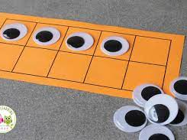
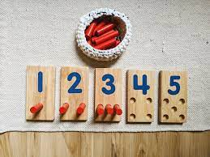
School Readiness
Goal: Children will use play to increase their understanding of symbolic representation as it relates to mathematical concepts such as one to one correspondence and cardinality.
Objective 1: Families understand how pretend play is connected to emerging/foundational mathematical skills.
One to One Correspondence: Children can point to an object and attach a rote counting number to it.
Cardinality: When children realize that the last number they counted is how many they have .
Example: Children can count the number on the die and then count that many space.
(PAT Parent Educator Resource: Beginning to Understand Number Concepts p.419)
Notes:
These 2 concepts: One to One correspondence and Cardinality are preschool concepts. Our goal for Early Head Start is to make
One to one correspondace: Each object gets one numbere. Each foot gets one sock.

Slide 5
https://gfletchy.com/2016/03/05/be-the-teacher-moving-from-counting-to-cardinality/
Notes:
Before children can even start counting they need to know so many different concepts and it needs to be repeated to the

Slide 6
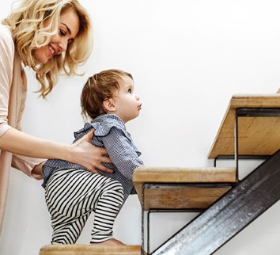
EHS Goal
Build the foundation of beginning math skills by providing opportunities to caregivers to teach their child counting, sorting, and comparing through pretend play & family routines.

Slide 7
Preoperational Thinking
Developed by psychologist, Jean Piaget.
Typically, around age 2.
At this stage children start increasing their language abilities.
Children still use their perception of how things look to solve problems.
They may think a cookie broken in 2 pieces is more than one whole cookie.
View questions personally
May answer all questions about quantity with their age.
Parents as Teachers Educator Resource: Beginning to Understand Number Concepts pg. 419
Notes:
How do we support rote counting.

Slide 8
3 Developmental Stages of Quantification
1. Global
Strongly using their perception as they quantify.
Most likely know the difference between one and many.
Can rote count but the words likely have no meaning to them.
Rote counting is an important first step towards counting.
2. One-to-One-Correspondence
Preschool age.
Look at an object and attach a rote counting number to it.
Still do not rely on counting to determine equality.
3. Counting
The last number they counted is how many they have. (Cardinality)
PAT Parent Educator Resource: Beginning to Understand Number Concepts Pg. 419

Slide 9
Classifying
Grouping similar items together.
Learning to compare items help children later in life with many different academic areas.
Helps them learn the difference between the letter p and the letter d.
When children are building their classifying skills, you will see them…
Line up objects
Start noticing that things are the same and different.
Start to notice that objects can fit into many categories.
Form ideas based on their own categories
All women with gray hair are grandmas.

Slide 10
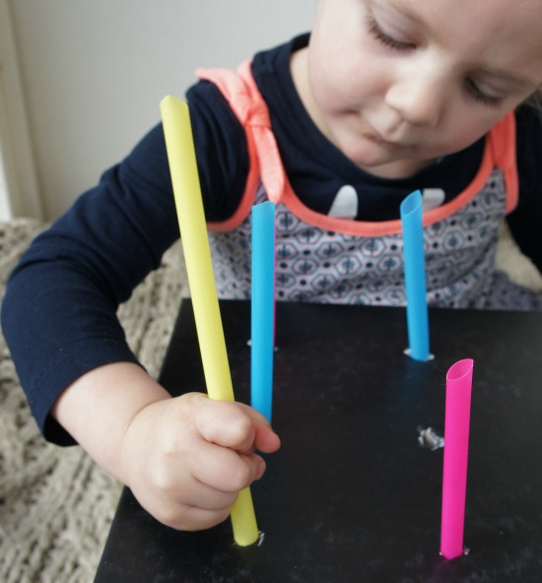
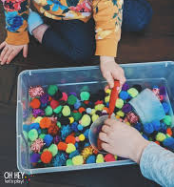
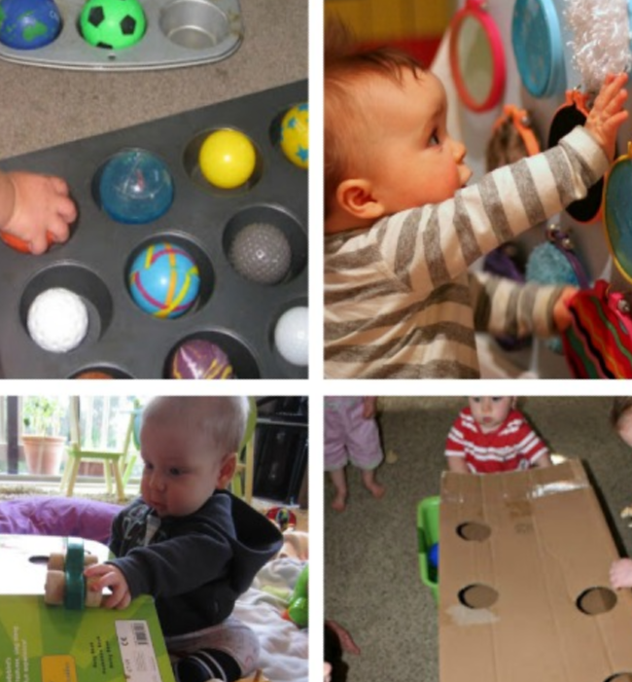
How do these activities promote number awareness?
Notes:
What discussions could you have with your families about how these activities promote number concepts?

Slide 11
School Readiness
Goal: Children will use play to increase their understanding of symbolic representation as it relates to mathematical concepts such as one to one correspondence and cardinality.
Objective 1: Families understand how pretend play is connected to emerging/foundational mathematical skills.
One to One Correspondence: Children can point to an object and attach a rote counting number to it.
Cardinality: When children realize that the last number they counted is how many they have .
Example: Children can count the number on the die and then count that many space.
(PAT Parent Educator Resource: Beginning to Understand Number Concepts p.419)
Notes:
These 2 concepts: One to One correspondence and Cardinality are preschool concepts. Our goal for Early Head Start is to make
One to one correspondace: Each object gets one numbere. Each foot gets one sock.

Slide 12
Cognitive Development Benefits of Pretend Play
Problem Solving
Orientation in place and time
Symbolic thinking- Research shows that pretend play helps children understand symbolism.
PAT Parent Handout: Pretend Play With Your Toddler. page 1110

Slide 13
As a Parent Educator
Help parents become aware that it is important and age–appropriate to help their child learn about math concepts in everyday life.
Research shows that the quality-of-care children receive form their caregiver directly influences their search for cognitive understanding of the world. (Parent-Child Interactions & Parenting Behaviors)
Provide opportunities and discussions in which parents can create an environment for learning about number and classifications.
Ask Open ended questions to parents and children.

Slide 14
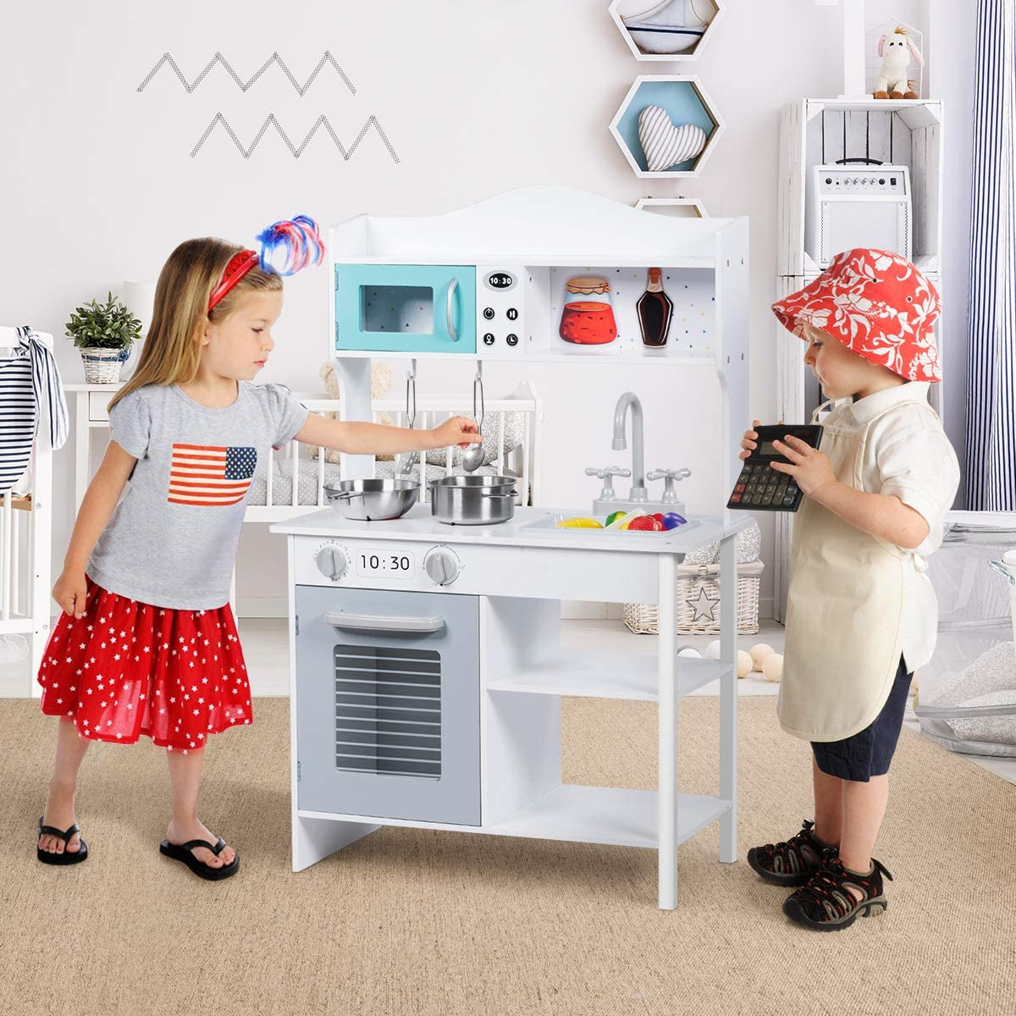
Emerging Mathematical Skills
Sizes: big, small, little, huge.
Shapes
Spatial words: in, under, between.
Spatial play: puzzles, nesting cups, etc.

Slide 15
Choosing toys and items that promote number concepts.
Group 1
What are some activities from PAT that support number concepts?
Group 2
What are some activities that you can suggest to parents that promote number and counting awareness throughout their daily routines?

Slide 16
Questions or Comments?

