Slide 1
Teaching Strategies Gold

Slide 2
What is Teaching Strategies Gold?
GOLD® is an authentic, ongoing, observation-based assessment system that relies heavily on your judgement as a home visitor. The information you collect every home visit by observing children in the context of meaningful experiences makes this instrument robust and effective. After analyzing the evidence you gathered to document each child’s knowledge, skills, and behaviors, you evaluate each child’s progress. You identify each child’s levels of development and learning at given points in time; track progress over time; and compare the child’s knowledge, skills, and abilities with widely held expectations for children of the same age or class/grade. Your evaluations inform the decisions you make when planning learning experiences for individual children and for your group as a whole.
Information Source: https://teachingstrategies.com/wp-content/uploads/2017/08/MyTeachingStrategies-How-To-Guide-for-Teachers_IRR.pdf

Slide 3
Interrater Reliability
Interrater reliability is an online certification process that gives you the opportunity to evaluate sample child portfolios and compare your ratings with those of Teaching Strategies’ master raters.
How To Access:
Log into Teaching Strategies Gold account.
Click on “Develop” at top of the screen.
Click on “Interrater Reliability,” at the top left of the screen.
From there, click “ Take Certification”
Choose Infants, Toddlers & Twos
Interrater Reliability Test will be completed every 3 years

Slide 4
Adding a new child to your class list
Login to your Teaching Strategies Gold Account
1. Click on the top right icon that Says “GOLD EHS-(your last name)”
2. Scroll down and click on: Manage “EHS-(your last name)”
3. Click on “Add child” on the left side of the screen.
4. Fill in tabs as necessary
Notes:
Student ID#: Leave blank
Funding Sources: Head Start
Free and Reduced Lunch: Unknown
IFSP: Answer accordingly
If choosing ‘yes’ for an IFSP, a message will appear:
Note: Self-care dimensions will not show up when you enter preliminary levels or checkpoint data until the date on which child is scheduled to begin to receiving IEP/IFSP services.
Assess this child using the Spanish Language and Literacy objectives: No

Slide 5
Inputting documentation (Image on next slide)
1. Login to your account
2. Click on ‘Add Documentation’
3. On Documentation Page:
-Click on child you are entering documentation for. Right side of screen.
- Files to Share: optional
- Date observed defaults to current day. Will need to adjust to day of observation.
- Family observation: toggle if it was observed by a family member.
-Notes: Enter anecdotal notes.
-Click on ‘Add Notes’
-Choose developmental area under Objectives & Dimensions
-Assign Objective/Dimensions (Encouraged)
-Hit Save (top right corner)

Slide 6
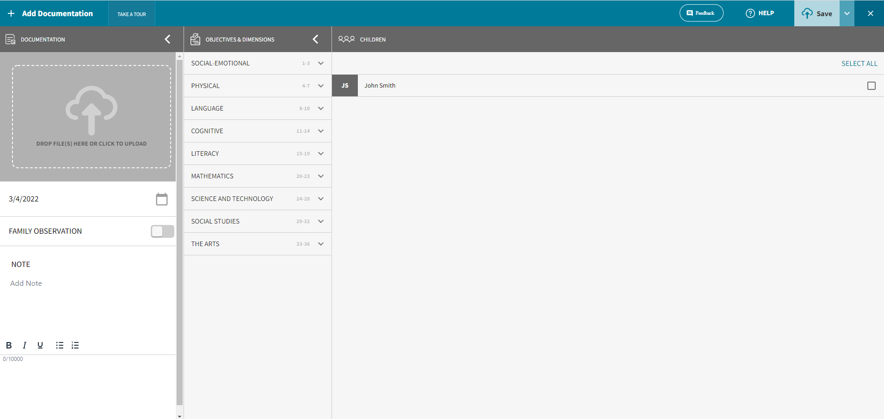

Slide 7
What are observation Notes?
Observation Notes: These are short, objective, factual notes about what you hear and see. Include direct quotations of language and description of actions, gestures, facial expressions, and creations.
-Keep your documentation simple. If you’re notes are too elaborate, you will have to take valuable time away from the visit.
What is Anecdotal note taking?
https://eclkc.ohs.acf.hhs.gov/video/collecting-using-anecdotal-records
https://www.youtube.com/watch?v=f0maUIIOOdU

Slide 8
Other Forms of observations (optional)
Photographs: Take pictures of children’s construction, artwork, or example of how they are demonstrating knowledge and skills related to an objective. Label each photo with the date and a brief note that explains the context in which it was taken.
Video and Audio Clips: Keep clips short. Capture just enough information to show an example of what the child knows and can do. Lengthy clips are difficult to store and locate.
Tools to assist with documentation:
-On the Spot Documentation through the TSGOLD.
- The Gold Documentation Mobile App. This is a resource for quickly capturing audio, video, text notes, or photos using iOS or Android mobile device. You can easily capture GOLD documentation in the moment and have the ability to immediately enter preliminary levels.

Slide 9
Directions for Downloading The Gold Mobile App
Search
Search for “GOLD Documentation” App.
Download
Download the app onto your mobile device. You will need an Apple ID and password to download the app from the App Store. Android users: Open the Google Play on your mobile device . You will need a Google username and password to download the app from the Google Play store.
Do not download
Do not download the “MyTeachingStrategies” App .

Slide 10
NMCAA EHS required areas of development
5 Ares of Development Required for Observation
Social-Emotional
Physical
Language
Cognitive
Literacy
*At a minimum, an observation should be entered once a month in each Area of Development per child (Social-Emotional, Physical, Language, Cognitive, Literacy)

Slide 11
Gold Objective and Dimensions
Areas of Development
Social-Emotional
Physical
Language
Cognitive
Literacy
Objectives
NMCAA looks at 19 objective
-Sub category under Areas of Development
- Ex: Objective 1 Regulates emotions and behaviors
Dimension
NMCAA looks at 44 dimensions
Guides teachers thinking about various aspect of an objective.
Not all objectives have dimensions
Example:
Objective 1 Regulates Emotions and Behaviors
Dimensions: a. Manages Feelings
b. follows limits and expectations.

Slide 12
Evaluating Child’s Progress
To make sure you are selecting the correct level, read the indicators to the right and left of your starting point. Choose the indicator that most closely matches the child’s skills and behaviors. Indicators often include multiple expectations (separated by semicolons). In order to rate a child’s skills as being at a particular level, the child must demonstrate skills related to all elements of the indicator. Also consider whether the child can best be described as being at an “in-between” level. “ (Teaching Strategies GOLD: Objectives for Development and Learning.Introduction xxii)
*Page xxi-xxii in Teaching Strategies GOLD: Objectives for Development and Learning.

Slide 13
GOLD Color bands
GOLD Color Bands
Used to indicate the age or class/grade ranges for these expectations.

Slide 14
Areas of Development & Learning → Literacy
Objective →
Dimension →
Rating scale →
Indicator →
(in bold)
Examples →
Expectations for ages→

Slide 15
Individual family service plan (ifsp)
-To add an IFSP to a previously enrolled child:
1. Click on the top right icon that Says “GOLD EHS-(your last name)”
2. Scroll down and click on: Manage “EHS-(your last name)”
3. Click on child
4. Scroll down to IFSP and click ‘yes’
-You must have the date on which child is scheduled to begin to receive IEP/IFSP services.
Note: New objectives and/or dimensions will open to score when child has an IFSP
-To remove an IFSP from a previously enrolled child:
1. Click on the top right icon that Says “GOLD EHS-(your last name)”
2. Scroll down and click on: Manage “EHS-(your last name)”
3. Click on child
4. Click on ‘OSEP Exit’ on the left side of the screen
5. Fill the requested information tabs accordingly.

Slide 16
EHS GOLD Observation guidelines
At a minimum, an observation should be entered once a month in each Area of Development per child (Social-Emotional, Physical, Language, Cognitive, Literacy)
Choosing Preliminary Level after each entered observation is strongly encouraged. More ribbons checked at the end of the quarter allows for better accuracy and a quicker finalization process.
At the end of each quarter, a minimum of 10 children should be finalized. There will be exceptions when a pregnant mom is enrolled.
If a child is dropped mid-quarter, talk with your PSC about whether the dropped and added child will both be finalized. This may be determined by quantity and quality of observations.

Slide 17
Finalizing checkpoints (example image on next slide)
Finalized checkpoints are due quarterly- the last working day of the month in November, February, May, and August.
1. To finalize a child’s checkpoint click on ‘Assess’ at the top of the screen and then on ‘checkpoint by child’ or ‘checkpoint by class’ (Home Visitor’s preference).
2. Once on the assessment screen, begin clicking on each Area of Development and then on each objective, choosing the most developmentally up to date option for each child.
3. When you have completed checkpoints for each Area of Development, you will click on the ‘Finalize’ button on the right of the screen. Continue this process for each Area of Development and all enrolled children.
There are 48 Objective/Dimensions to finalize.
When to choose ‘Not Yet’ or ‘Not Observed’
Not Yet: when the earliest indicator is not a reasonable expectation for the child of that age. The child is not expected to begin demonstrating that skill or behavior.
Not observed: only on rare occasions, such as when the child has been in the program for only a few weeks or has had significant absences during the checkpoint period.

Slide 18
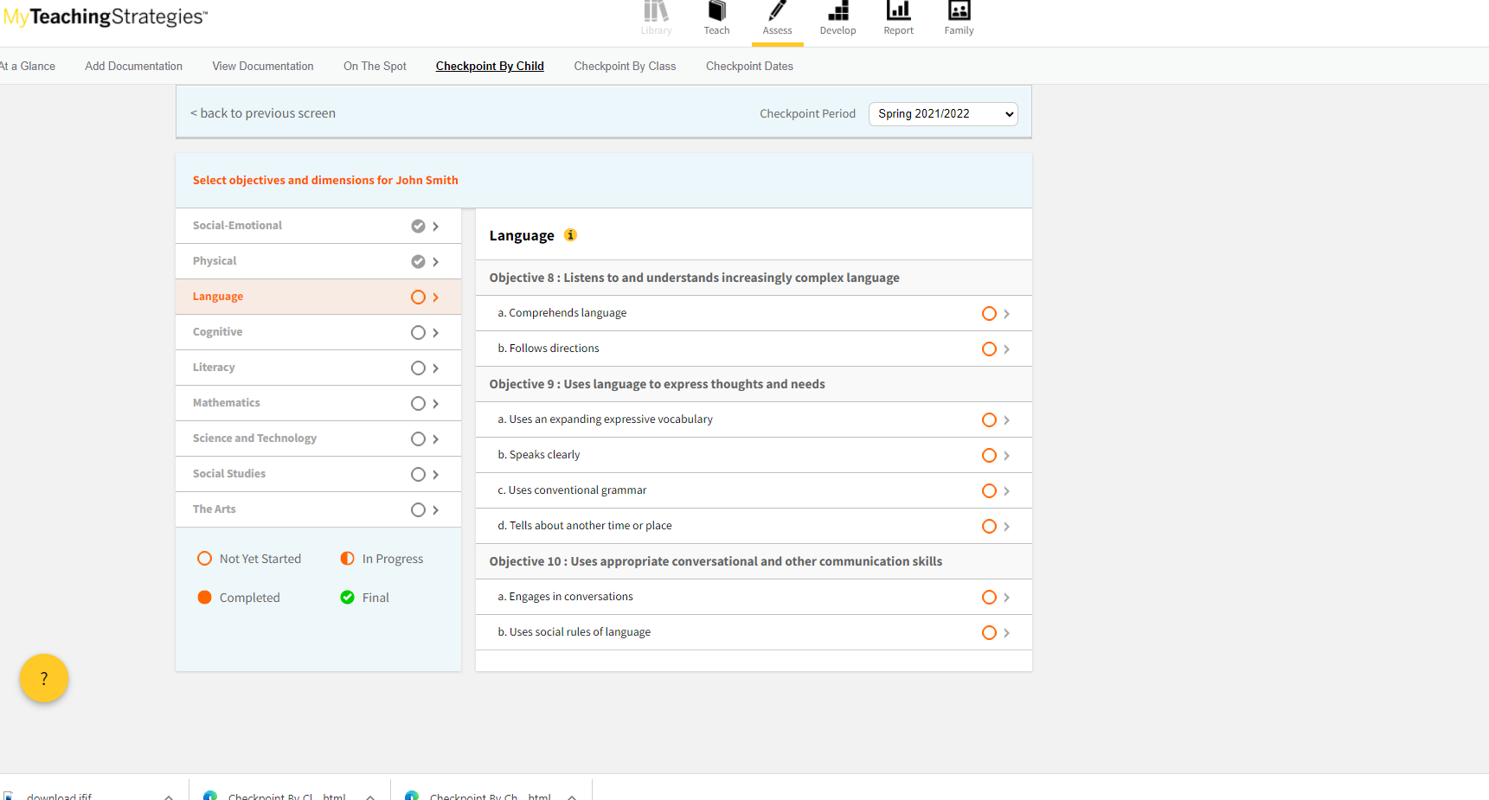
Checkpoint by Child Example

Slide 19
Post checkpoint reports
-To print a Post Checkpoint Report,
1. Click on ‘Report’ at the top of the screen.
2. From there, scroll down to ‘Development and Learning’ and click ‘Go’.
3. Choose your class, child, and checkpoint period.
4. Choose EHS’s 5 Areas of Development and Learning
(Social-Emotional, Physical, Language, Cognitive, and Literacy)
5. Include: Finalized Checkpoints Only
6. Print 2 Copies
- 1 copy of child’s quarterly Development and Learning report is required to be filed quarterly in each child’s individual file.
- 1 copy of a quarterly report is given to the family along with a discussion about the child’s progress. Choose a report that best fits your enrolled family’s needs.

Slide 20
Archiving
Archiving a child is completed when a child has transitioned to a preschool program or has exited the Early Head Start program.
Finalize checkpoints of child before being archived.
Program Service Coordinator (PSC) will archive child.

Slide 21
Teaching Strategies Gold Webinars
Log into Teaching Strategies Gold account.
Click on “Develop” at top of the screen.
Click on “My Courses” at the top left of the screen
Options:
Gold Introduction (2 hours)
Objectives for Development and Learning (10 hours)
Introducing My Teaching Strategies (2 hours)
Link to written guidance on TSGOLD (May need to be logged in to access) https://teachingstrategies.force.com/portal/s/article/View-Documentation-Teachers#NavView

Slide 22
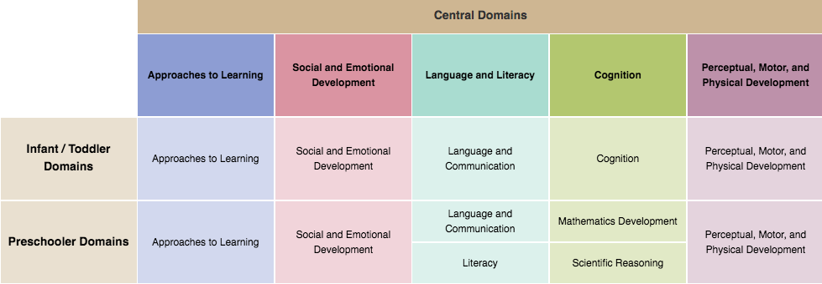
Head start Early learning Outcomes Framework (ELOF)
The Head Start Early Learning Outcomes Framework: Ages Birth to Five describes the skills, behaviors, and knowledge that programs must foster in all children. ... It describes how children progress across key areas of learning and development and specifies learning outcomes in these areas.

Slide 23
Early Head Start early Learning Outcomes
The Head Start Program Performance Standards require grantees to implement program and teaching practices that are aligned with the ELOF.
Early Head Start aligns ELOF with Teaching Strategies Gold objectives and/or dimensions to allow for home visitors to implement effective teaching practices.

