Slide 1
Visit Preparation & Opening
Parents as Teachers

Slide 2
Agenda
PAT Visit Preparation Overview
Breakout
PAT Opening Overview
Breakout

Slide 3
Visit Preparation
Review
Consult
Check in
Go back to previous personal visit plan, milestones, and personal visit record.
Complete the actions or follow-up from last visit.
Talk with your supervisor, IMH support, coworker for support.
Reference Parent Educator Resources and choose 2 key points to share with family.
Restate to the family what your plan will be for the visit.
Touch on PAT activity, and Development Centered Parenting topic.
Ask if there is anything else the parent would like to discuss.

Slide 4
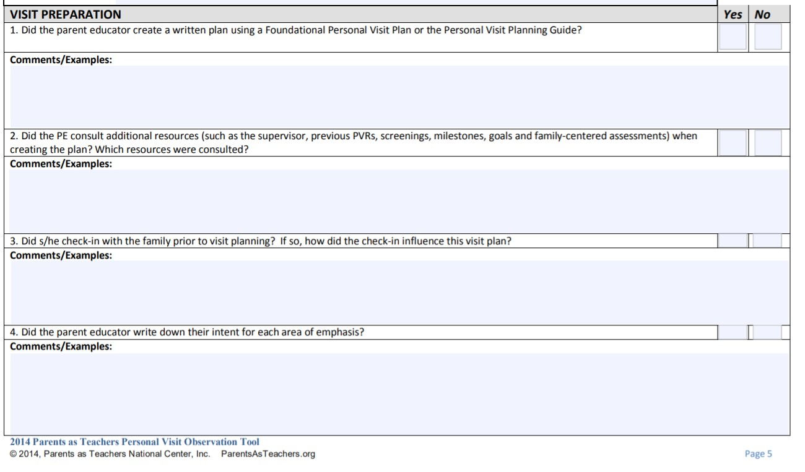
https://www.nmcaaehs.com/uploads/2/4/0/2/24026312/pat_personal_observation_tool.pdf

Slide 5
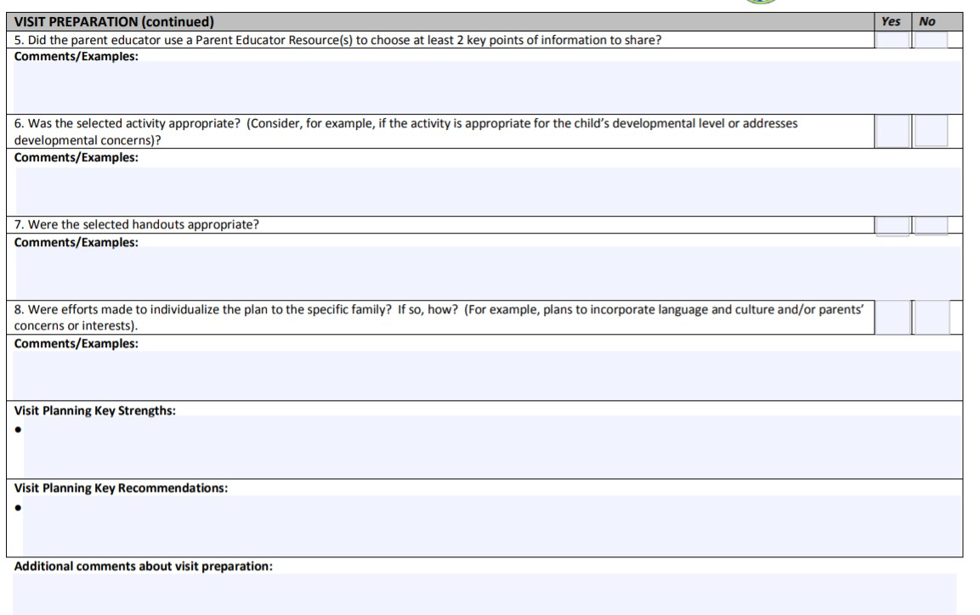

Slide 6
How do you prepare for a home visit?
15-minute breakout

Slide 7
Opening
Connect
Reflect
Agree
Connect around something positive you noticed about the home, child(ren), or parents or the result of a positive parenting behavior.
Share the results of your follow-up from last visit and ask parents how things went with theirs.
Ask the parent what they noticed about their child since the last visit.
Reflect on the parents’ and child(ren)’s experience with the activity.
Ask:
“What did you notice about your child’s play?”
“How did she check back in with you during play?”
“What are your questions from our last visit?”
Agree on what will happen during the visit.
“We plan to explore your child’s dev. through _______(PAT Activity).”
“You mentioned from the check in you wanted to discuss _____.”
“What else would you like to talk about or address?”

Slide 8
PAT Personal Visit Observation Tool

Slide 9
How do you connect around the last visit, ensuring In-kind hours are collected & reflect on what has happened since the last visit?
15-minute breakout

Slide 10
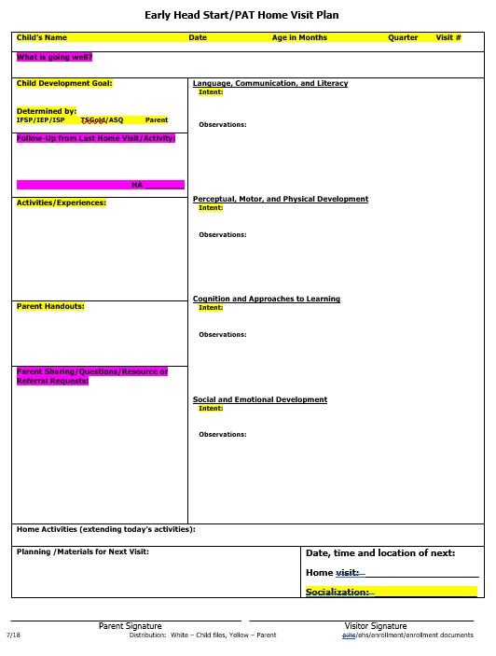
*Items to be completed prior to entering home
*Items to complete at opening of visit and throughout

