Slide 1
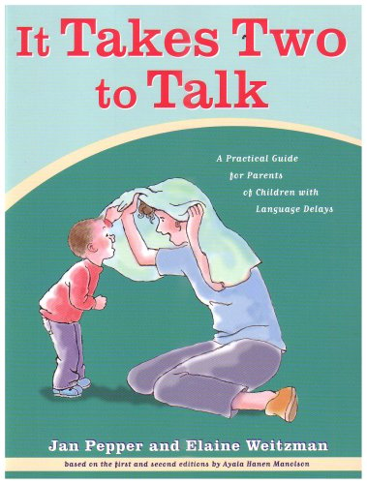
It Takes Two to talk
Hanen Speech and Language Support

Slide 2
It Takes Two to Talk Guidebook Practical Guide for Parents of Children with Language Delays
Recognize your child’s stage and style of communication so that you know which steps to take next
Identify what motivates your child to interact with you so you’ll know how to get conversations started
Adjust everyday routines to help your child take turns and keep interactions going
Follow your child’s lead to build his confidence and encourage him to communicate
Add language to interactions with your child to help him understand language and then use it when he is ready
Tweak the way you play and read books with your child to help him learn language
Change the way you speak to your child so that he’ll understand and learn new words

Slide 3
Stages of Communication pg. 4
Discoverer react to how they feel and to what is happening around them, but do not communicate with a specific purpose in mind.
-Communicates through facial expressions and body movements.
Communicators send specific messages without using words.
First Word Users use single words, signs, or pictures.
Combiners combine words into sentences of two or three words.

Slide 4
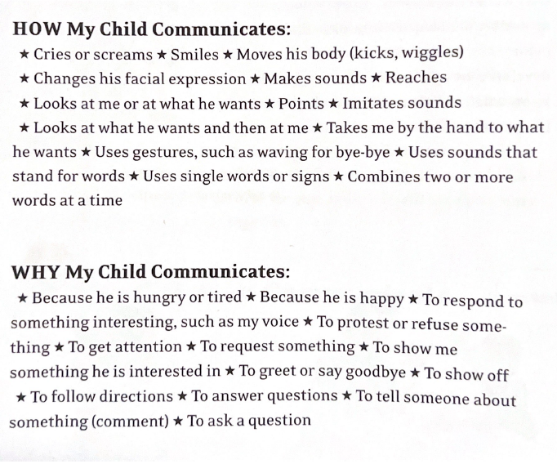
Page 4 of It Takes Two To Talk

Slide 5
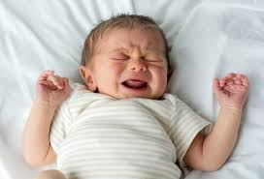
Discoverer
Description:
Do not communicate with a specific purpose in mind
Not able to understand words yet.
How Discoverer Communicates:
Reacts to how he is feeling and to what is happening around him.
Communicates through facial expressions, body movements, and loud and soft sounds.
What Discoverers Understand:
Becoming aware of the world around him.
May start to anticipate sounds

Slide 6
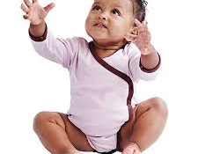
Communicator
Description:
Send specific messages without using words
How Communicator Communicates:
Understands that he can make things happen.
Example: Holds arms out, they know you will pick him up.
Looking at you, making gestures, pointing, grunting.
Late stage of communicator, learns to follow the focus of an adult. This allows for language learning opportunities.
What Communicator understands:
Beginning to understand the common words being used.
Begin understanding simple directions.
Notes:
Receptive language

Slide 7
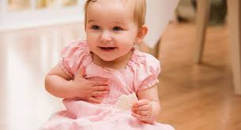
First Word Users
Description:
Uses single words, signs, or pictures.
How First Word Users Communicate:
Imitating words or start to use words by themselves.
Will continue to use sounds, words, and gestures.
Use one word to express whole message.
What First Word Users Understand:
Understands simple directions with gestures.
“get your cup”
Notes:
Expressive:

Slide 8
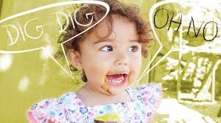
Combiners
Description:
combine words into sentences of two or three words.
How Combiners Communicate:
Often when a child learns about 50 words, they are ready to start combining words. “more juice” or “Mommy up”
Start using less gestures.
What Combiners Understand:
Understands many simple directions without the help of gestures.
Combiners can also identity an object not only by its name, but why what you do with it.
For example, if you ask, “show me what you eat.” He points to his food.
Notes:
Telegraphic speech: articles such as “the” or “a” are not yet present. Thus the name telegraphic speech because it is similar to those language used in telegrams. Typically only have a noun and a verbor a noun and a modifier
Drink juice
Where go?
My dolly?
No bed
Pat page 365

Slide 9
Let your Child Lead
Get face to face with your child
When you are face to face, you can connect more easily and share the moment.
Both of you can hear and see each other’s messages better.
It’s easer for you to encourage your child to take the lead.

Slide 10
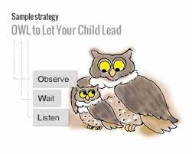
OWL
Observe your child’s body language, actions gestures, and facial expressions to help understand what they may be trying to say or what they are interested in.
Wait- Stop talking, lean forward, and look at your child expectantly.
-Count slowly to 10
-The most important part of this stage to remember is to give your child enough time to understand that you expect her to send you a massage- any message whether is be through sounds, words, or gestures.
Listen: paying close attention to all your child’s words and sounds. Take care not to interrupt.
Page 20-22 In It Take Two to Talk goes into detail about how to engage your child in the OWL process dependent on their stage of communication.

Slide 11
Hanen Technique: OWL When Reading
Observe | Pause during the book reading and observe your child to see where their focus goes. Wait for your child to provide a cue based on their stage of development. Offer a comment or an open-ended question as a response.
Wait | Wait 5-10 seconds for your child to respond to your comment or question.
Listen | Listen to what they have to say and respond to them with a comment or question. If your child doesn’t respond, you can offer a response. Wait and see if they respond again.
Notes:
Owl technique provides opportunities for conversations and language practice which supports the 2 tsgold objectives of engages in conversation and speaks clearly.
Speaks clearly and engages in conversation

Slide 12
Building conversation through songs
Choose a song that your child knows well.
Start by singing the song and pause right before the high point or the best part of the song.
Wait 5-10 seconds to see if your child fills in the words or uses a gesture or a sound to keep the song going.
Tips:
-Once your child understands, continue adding pauses throughout the song for your child to fill in the blank through gestures, words, or sounds.
- If your child doesn’t respond, you can fill in the words and add a gesture to emphasize what you're doing. Continue practicing with your child.
Notes:
Twinkle twinkle little star, how I wonder what you ARE
Up above the world so high

Slide 13
Hanen Resources http://www.hanen.org/Home.aspx
Book Nook: Videos that each about emerging reading skills.
http://www.hanen.org/Helpful-Info/Book-Nook.aspx
Tips for Parents
http://www.hanen.org/Helpful-Info/Parent-Tips.aspx

