Slide 1
Google Drive
My Drive, Shared with me, Starred
Create Files & Folders
Sharing Files & Folders
What is Google Drive?
DISCLAMER: I am self taught & still learning ☺
Drive Search Bar

Slide 2
What is Google Drive?
Google Drive is a cloud-based storage solution that allows you to save files and folders online and access them anywhere from any smartphone, tablet, or computer.
You can use Drive on your computer or mobile device to securely upload files and edit them online.
TIP: think of Google Drive & use it like your computer desktop (files & documents)
Like Dropbox, One Drive, iCloud

Slide 3
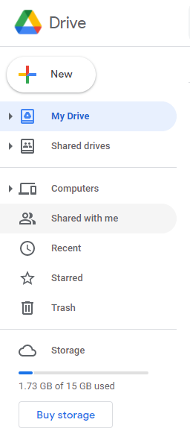
Create new folder, upload documents, create new document
Folder & Files you created or shortcuts you added
Files & folders that were shared with you by email or link
Think of it as a favorites or bookmark- right click folder/file select Add to Starred
Your Google Account starts with 15 GB of free storage to use across Google Drive, Gmail, and Google Photos.

Slide 4
Create Folders & Files/Documents
To organize your files in Drive, you can create folders to make files easier to find and share with others.
Google Docs = word document
Google Sheets = Excel
Google Forms = surveys & polls
Google Slides = power-point
Folder
File/document
Click create
Name Folder
Click one (Docs, Sheets, Slides, Forms

Slide 5
HOW TO SHARE You can share the files and folders that you store in Google Drive with anyone. When you share from Google Drive, you can control whether people can edit, comment on, or only view the file.
Right click on file or folder you want to share
1
Click share
2
Share by email or by link
may need to change control setting
3
Reminder: Folder shares everything that folder & File share only that document

Slide 6
Using the Search options
Use the icon to the right for more search options

Slide 7
Additional Thoughts
When items are shared by email recipient will get a email notification shared with them, and it will be in their Drive under the Shared with Me.
When you use the Link option to share items it will not be in the Drive under Shared With Me unless the link is clicked. Once clicked the file/folder will be on your Drive.
You can create a short cut for the items that are Shared with you so they are under your “My Drive” or you can add it to “Starred”
Reduces the need to save emails with links
Bookmark Google Drive
Google Sheets
Keyboard Shortcuts – Ctrl+f
HELP Option

