Slide 1
Ehs academy
Supporting and engaging families in their child’s language journey through rhymes, songs and books.

Slide 2
Introductions
Share your name
Favorite Children’s Book

Slide 3
“Don’t think of reading as something you do to your child; think of it as something you do with your child.”
-Hanen Centre
Notes:
This quote sums up what we will talk about today. We are going to discuss how to engage and interact with your child during literacy experiences.
The quote reads. …

Slide 4
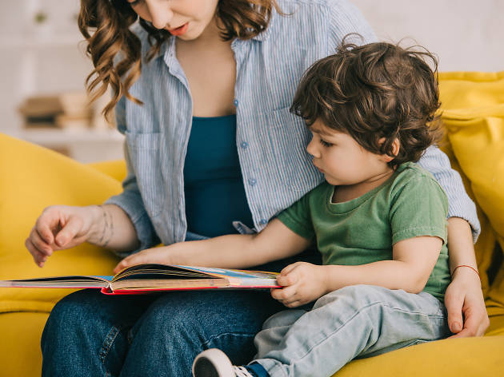
3 Language and Literacy Objectives
Parents as Teachers (PAT)
Professional Development Practices
Language & Literacy

Slide 5
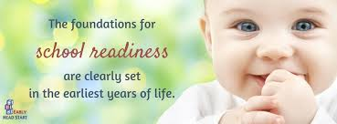
School Readiness Goals
Approaches to Learning
Children will demonstrate positive approaches to learning by attending and engaging
Social Emotional Development
Children will increasingly regulate their emotions and behaviors in order to participate cooperatively in group situations
Language and Communication
Children will use language to express their needs, ask questions, and engage in short conversations in a variety of settings
Literacy (4-5 years)
Children will demonstrate phonological awareness by noticing and discriminating smaller units of sound
Cognition
Children will use play to increase their understanding of symbolic representations as it relates to mathematical concepts such as one to one correspondence and cardinality
Perceptual, Motor and Physical Development
Children will demonstrate safe and healthy behaviors with increasing independence with support from adults

Slide 6
School Readiness Grant Goals | Fall | Winter | Spring | Summer
Approaches to Learning: 11a Demonstrates positive approaches to learning – Attends and engages | 98% | 96%
Cognitive 14 Uses symbols and images to represent something not present | 91% | 87%
Perceptual, Motor, Physical 1c: Takes care of needs appropriately | 92% | 92%
Social Emotional 1c: Regulates own emotions and behavior | 90% | 92%
Communication and Language: 9b: Uses language to express thoughts and needs – speaks clearly 10a: Use appropriate conversational and other communication skills – engages in conversations | 89% 90% | 86% 84%
Literacy 15a: Notices and discriminates rhyme | 89% | 82%

Slide 7
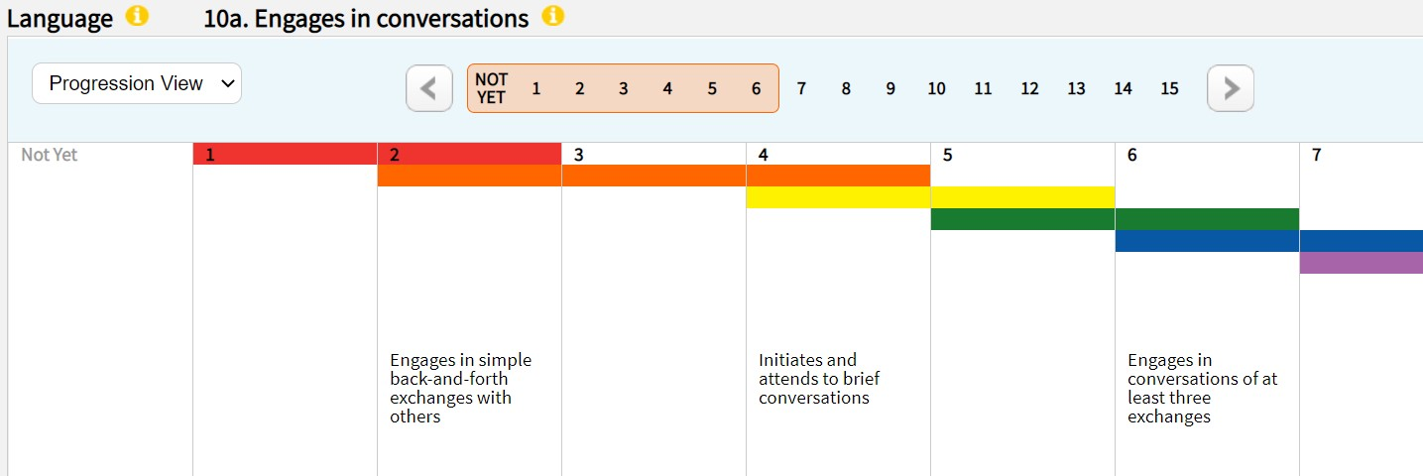
language & Literacy
Notes:
-We are going to look at these 3 dimensions from TSGOLD.
-We will look at the first 2 dimensions together and talk about techniques to engage families.
-And then we will look at 15a. Notices and discriminates rhymes.

Slide 8
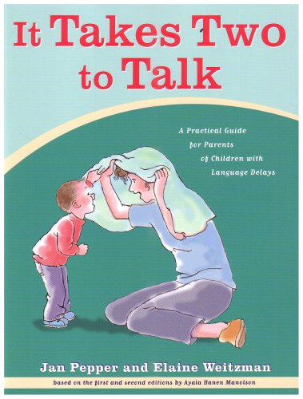
Stages of Development
O.W.L (Technique)
Listen and Find One Like It (Technique)
Notes:
The information provided from Hanen today comes from this resource, It Takes Two to Talk and also from hanen.org.

Slide 9
NMCAA EHS professional Development Practices
Top 5 Chosen Practices
I connected around a conversation from the previous visit that was focused on language and literacy. (PAT #9)
During language and literacy activities, I facilitate one or more parenting behaviors; Nurturing, Designing/guiding, Responding, Communicating, Supporting Learning. I facilitate one or more parenting behaviors; Nurturing, Designing/guiding, Responding, Communicating, Supporting Learning. (PAT #12)
I get information from open-ended or follow-up questions and use the information to increase effectiveness of home visit when talking about language and literacy. (HOVRS #3.7)
During language and literacy activities, I encourage or reinforce and prompt positive parent-child interactions. (HOVRS #5.7)
I bring up issues respectfully and ask questions to help parent reflect on parenting when discussing language and literacy activities. (HOVRS #8.7)
Notes:
Two in yellow are really the same idea one originates from PAT and the other from HOVrs- focuses on positive parent child interaction
3 in gray talk about conversations with the parent. How are we asking open ended questions, reflecting on previous visits and parenting skills.

Slide 10
PAT
Repetition
Rhythm
Rhymes
Valuable Tools for Teaching Language

Slide 11
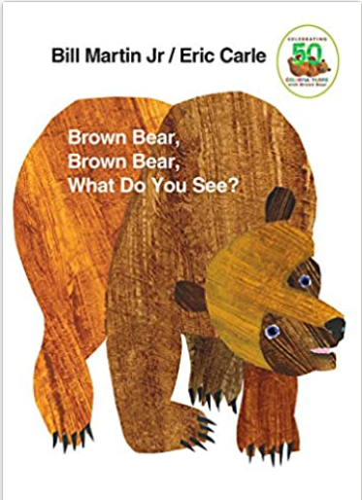
Repetition
Hear correct pronunciation of words.
Allows children to anticipate the words they will hear.
Notes:
-They are born able to hear and process all speech sounds contained in all the world’s language.
-In order to incorporate a sound into their own speech, they must hear it spoken to them over and over again.
Example: obnoxious
Books with repetitive text
There is a really nice chart in PAT on page 415 that show what speech sounds 3 year olds can pronounce and what they are learning to pronounce.

Slide 12
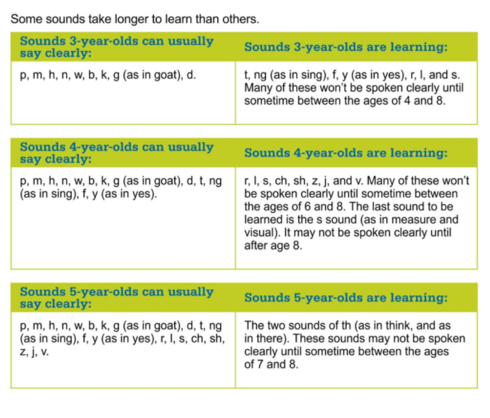
Notes:
Page 415

Slide 13
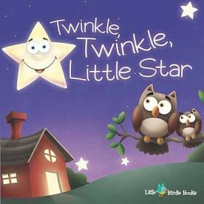
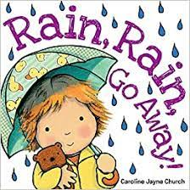
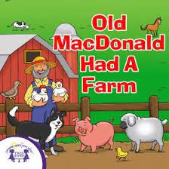
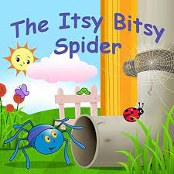
Rhythm
Babies have an inborn sense of beat awareness.
Attracts babies and toddlers’ attention.
Rhythm promotes other areas of development.
Notes:
- Most physical activities involve rhythm and have a beat ­– crawling, walking, running, hopping, skipping, kicking, throwing and so on. - - - Mastering keeping a beat or humming a song intune enables your child to play more sophisticated games with other children, which then gives them opportunities to make friends, which in turn encourages them to develop social skills and increases their enjoyment of life.

Slide 14
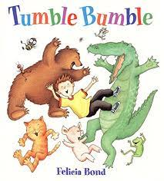
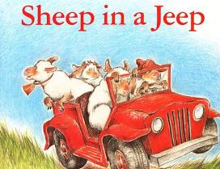
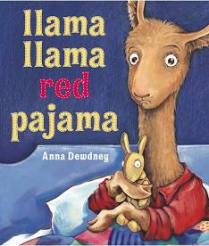
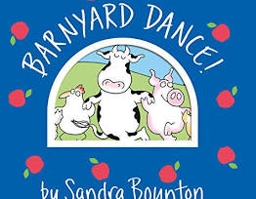
Rhymes
Rhymes provide practice in hearing the same sound repeated in different ways and tones.
Babies learn language by mentally categorizing sounds in groupings that sound similar.

Slide 15
Attractive Elements to book reading
Actions
Interesting Subject Matter
Predictability
Large Print that Matches Illustrations of the Story.
A Sense of Playfullness
Notes:
1. Actions: when children act out stories and sing different songs, many areas of the brain are active and learning is enhanced. (From Head to Toe)
2, Interesting subject matter: The key to engaging your child is finding books or topics that your child enjoys. Also think about background information. Think about what is important to the families, what’s specific to the culture of the family when picking books.
3. Predictability When we choose books that are predictable, it helps children follow the story line and allows him to actively participate in guessing what will happen next. (Brown Bear, Brown Bear)
4. Large Print that matches the illustrations of a story. When picture match the words, children are able to gain cues about what unfamiliar words represent. .
5. A sense of playfulness: often, nursery rhymes, songs, and stories provide a fun, warm way for caregivers and children to play together. They help develop attachment when they are a regular part of the care providers loving interactions with the child.
Can you think of a book that fits all or most of the categories listed here?

Slide 16
Breakout
1. Talk about what books, nursery rhymes, and fingerplays incorporate multiple components we discussed.
2. How have you engaged parents and caretakers in conversations around literacy and language?

Slide 17
Stages of Communication

Slide 18
Stages of Communication
Discoverers
Communicators
First Word Users
Combiners

Slide 19
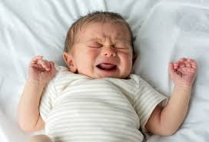
Discoverer
Description:
Do not communicate with a specific purpose in mind
Not able to understand words yet.
How Discoverer Communicates:
Reacts to how he is feeling and to what is happening around him.
Communicates through facial expressions, body movements, and loud and soft sounds.
What Discoverers Understand:
Becoming aware of the world around him.
May start to anticipate sounds

Slide 20
Communicator
Description:
Send specific messages without using words
How Communicator Communicates:
Understands that he can make things happen.
Example: Holds arms out, they know you will pick him up.
Looking at you, making gestures, pointing, grunting.
Late stage of communicator, learns to follow the focus of an adult. This allows for language learning opportunities.
What Communicator understands:
Beginning to understand the common words being used.
Begin understanding simple directions.
Notes:
Receptive language

Slide 21
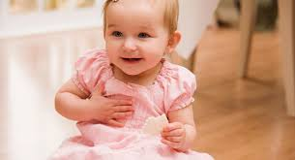
First Word Users
Description:
Uses single words, signs, or pictures.
How First Word Users Communicate:
Imitating words or start to use words by themselves.
Will continue to use sounds, words, and gestures.
Use one word to express whole message.
What First Word Users Understand:
Understands simple directions with gestures.
“get your cup”
Notes:
Expressive:

Slide 22
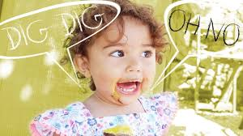
Combiners
Description:
combine words into sentences of two or three words.
How Combiners Communicate:
Often when a child learns about 50 words, they are ready to start combining words. “more juice” or “Mommy up”
Start using less gestures.
What Combiners Understand:
Understands many simple directions without the help of gestures.
Combiners can also identity an object not only by its name, but why what you do with it.
For example, if you ask, “show me what you eat.” He points to his food.
Listen to short simple stories
Notes:
Telegraphic speech: articles such as “the” or “a” are not yet present. Thus the name telegraphic speech because it is similar to those language used in telegrams. Typically only have a noun and a verbor a noun and a modifier
Drink juice
Where go?
My dolly?
No bed
Pat page 365

Slide 23
Engages in conversation & Speaks Clearly

Slide 24
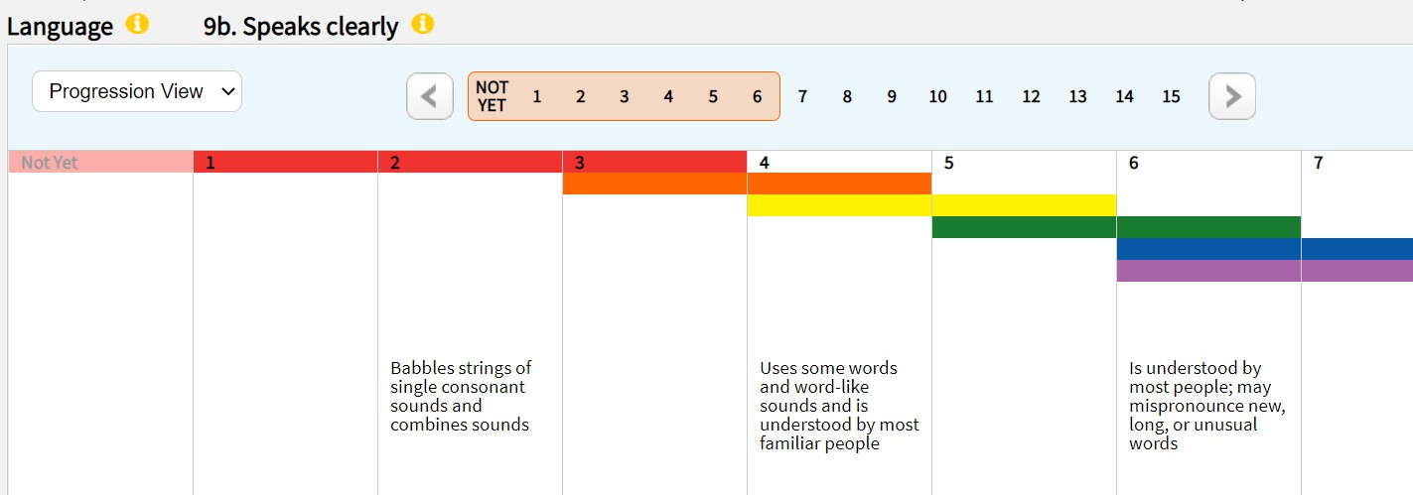
Notes:
So now that we have some background knowledge of how Hanen looks at language development. We are going to apply it TSGOLD.
I like to think of each stage of development as fitting into TSGOlD color bands.
Red could fit discovered and communicator.
Orange could be a communicator or firt word user
Yellow can be a first word user and combiner.
We are going to look at the Owl technique, watch a video, and then discuss how to apply this technique with enrolled families.

Slide 25
Hanen Technique: OWL
Observe | Pause during the book reading and observe your child to see where their focus goes. Wait for your child to provide a cue based on their stage of development. Offer a comment or an open-ended question as a response.
Wait | Wait 5-10 seconds for your child to respond to your comment or question.
Listen | Listen to what they have to say and respond to them with a comment or question. If your child doesn’t respond, you can offer a response. Wait and see if they respond again.
Notes:
Owl technique provides opportunities for conversations and language practice which supports the 2 tsgold objectives of engages in conversation and speaks clearly.

Slide 27
Building conversation through songs
Choose a song that your child knows well.
Start by singing the song and pause right before the high point or the best part of the song.
Wait 10 seconds to see if your child fills in the words or uses a gesture or a sound to keep the song going.
Tips:
-Once your child understands, continue adding pauses throughout the song for your child to fill in the blank through gestures, words, or sounds.
- If your child doesn’t respond, you can fill in the words and add a gesture to emphasize what you're doing. Continue practicing with your child.

Slide 28
Break Out
Have you used it before? How did it go?
How can you share this technique with your families?
What are other techniques have you used to support engaging children in conversations?
How can you engage families in conversations around this TSGOLD objective?

Slide 29
Noticing and Discriminating Rhymes

Slide 30
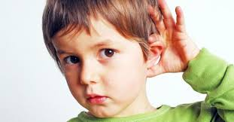
Listen and Find one like it
Notes:
Most kids in Ehs will not be able to do this skill. That’s okay.
Altohough the majority of children enrolled will not be verbalizing rhymes. We should look for communication in different forms. Is the child engaged? Are they clapping? Making eye contact?

Slide 31
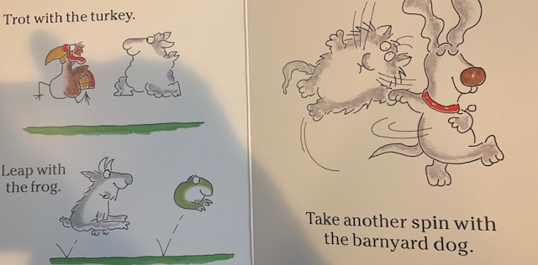
Hanen: Listen & Find one like it.
Listen to rhymes and identify them.
“Listen, ‘frog’ and ‘dog’, those words sound the same at the end. They rhyme!”
2. Find one like it
“Let’s think of another word that rhymes with ‘frog’ and ‘dog’. Hmm, ‘log’ rhymes with ‘frog’ and ‘dog’. They sound the same at the end!”

Slide 32
Listen & Find one Like it.
TIPS:
If it’s the first time reading a book and you don’t want to stop reading, you can emphasis the rhyming words. Say the rhyming words slower and louder so that the words stand out to the child.
As you re-read the book, focus on different rhyming words.
Most young kids won’t be able to think of rhymes yet, that’s okay. Continue to share the idea of rhyming and examples to help build your child’s awareness.
Notes:
What are some books that you enjoy that you could use the Listen and fine one like it technique?

Slide 33
Breakout 10 minutes
What are your thoughts on the Hanen technique, Listen & Find One Like It?
What are other techniques you have used to support noticing and discriminating rhymes?

Slide 34
Final thoughts or questions?
Notes:
We know that joining in rhyming and filling in missing rhymes is an advance skill for the age group that we work with. What are some techniques that you have used or have learned about that might support children in learning how to discriminate rhymes?

