Slide 1
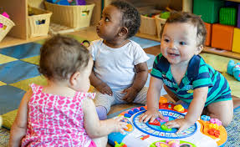
Early Head Start
3.8.21

Slide 2
Welcome EHS! And a special welcome to our new staff: SocializationSpecialists: Kerrigan and Erica Child and Family Specialists: Senecca and Alexie Welcome to our team!!
I will have the PSC’s and Coach introduce their teams, please share your position, area you work and what you most look forward to this spring.
Rebecca
Emily
Tara
Marissa

Slide 3
Inclusion
We will join break out rooms in groups of 4
Find 5 things you have in common
Cannot be work related!
Think about:
Hobbies
Kids
Pets
Vacations

Slide 4
Health
 | Fall | Winter | Spring | Summer
Medical Home | 80% | 74%
Health Coverage | 93% | 91%
Dental Home | 35% | 38%
Hearing Screenings Up to Date | 92% | 88%
Vision Screenings Up to Date | 92% | 88%
Health

Slide 5
Large Group: Surprises? What’s going well? What changes might we need to make? Reminders:
We went down in all areas except dentals, this may be due to enrolling more families in the middle of the year than we typically do. It will be important to follow up with all families that do not have a medical home listed on their application, find out if they have a medical home/health insurance and get that to your R & H as quickly as possible.
Dental homes increased!!! Many of you are working really hard with families to educate them as to why a dental appointment at age 1 is so important. Please remember that if a family does not have a dental home, it must be noted in Need Identified – Dental Education, and you must use our dental curriculum to assess the education the family might need and follow through with that content.
Hearing and visions – COVID cannot be used as a reason the screening was not done, unless the family is refusing to complete it. If you are a staff member that is only working virtually, it will be important to work with your PSC to complete the screening another way, whether that is a clinic or another teammate completes it. Also, remember to follow-up on referrals and share progress with the R & H
What are some things you are doing differently that has been helpful or changed your perspective on health?Share some aha moments.What is going well with health?

Slide 6
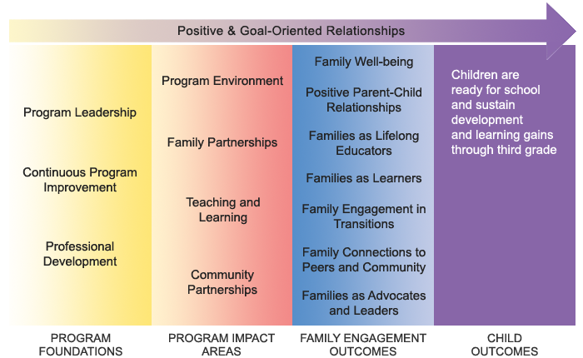
 | Fall | Winter | Spring | Summer
In Goal Setting Process | 80% | 84%
Active Partnership Agreement | 87% | 87%
Need Identified | 81% | 93%

Slide 7
Ideas and Reminders
Don’t forget to go into the Family Services Information tab when the FPA is signed and goals are set with families
Remember to put an Effective date in or it will not show up as being complete
Reviewing the goal monthly is mandatory, even if there are no changes, note the follow-up in CP.
There is a lot to remember, but using the top portion of the In Kind form should support you in completing all the monthly follow-up including goal follow-up, health follow-up and socialization follow-up

Slide 8
Disability
 | Fall | Winter | Spring | Summer
IFSP | 15% | 14%

Slide 9
Supporting families with children with disabilities
10% of our children must have a diagnosed disability
It is important that we collaborate with Early On staff:
Print out the IFSP for the child’s file
Review the IFSP goals in order to support the goals at home visits
Stay in contact with Early On staff, ensuring that whenever possible you join IFSP reviews

Slide 10
Eligibility
 | Fall | Winter | Spring | Summer
Foster Care | 4% | 3%
Homeless | 10% | 10%
Below 100% | 50% | 50%
101-130 | 13% | 12%
Over Income | 9% | 9%
Public Assistance | 3% | 16%

Slide 11
Supporting Recruitment
It is everyone’s job to recruit.
We are still struggling to be full, this is common across all Head Start and Early Head Start programs
How can we recruit differently to reach families?

Slide 12
Attendance
Attendance: 2020-21 – 245 families for full enrollment
 | In person | Virtual | Phone | Family Cancelled | Not Scheduled | Staff Cancelled | Bad Weather | Holiday | COVID | No one home
September 223 enrolled 88% | 28% | 47% | 13% | 19% | 3% | 2% | 0 | 0 | ½% | 1%
October 223 enrolled 81% | 31% | 42% | 7% | 26% | 4% | 1% | 0 | 0 | 0 | 2%
November 219 enrolled 73% | 14% | 50% | 8% | 21% | 3% | 5% | 0 | 1% | 0 | 1%
December 217 enrolled 74% | 5% | 57% | 12% | 25% | 9% | 4% | 0 | 10% | 0 | 1%
January 233 enrolled 75% | 9% | 53% | 12% | 17% | 2% | ½% | 0 | ½% | 0 | 2%

Slide 13
 | 2017-18 | 2018-19 | 2019 – 20 | 20-21
September | 73% | 74% | 67% | 88% 220/245 families enrolled
October | 89% | 89% | 91% | 81% 221/245 families enrolled
November | 68% | 74% | 71% | 73% 219/245 families enrolled
December | 54% | 60% | 63% | 74% 217/245 families enrolled
January | 85% | 71% | 84% | 75% 233/245 families enrolled
17/18 – 18/19 – 19/20 – 20/21 School Year
In the past three years, our attendance yearly has been between 75 and 75%; this year we are at approximately 78%!!
During this really difficult time, I know there have been a lot of concerns regarding attendance, but this priority is reflected in the data! Congratulations!!

Slide 14
 | % of indicators below expectations |  |  |  | % of indicators at or above expectations
Date | 11/30 | 2/28 | 5/31 | 8/31 | 11/30 | 2/28 | 5/31 | 8/31
Social-Emotional | 13% | 12% |  |  | 87% | 88%
Perceptual, Motor, Physical | 8% | 6% |  |  | 92% | 94%
Approaches to Learning | 6% | 6% |  |  | 94% | 94%
Cognitive | 5% | 6% |  |  | 95% | 94%
Communication, Language | 16% | 15% |  |  | 84% | 85%
Literacy | 15% | 19% |  |  | 85% | 81%

Slide 15
5 year grant
Primary and expansion grant combined March 3, meaning all of EHS and HS will be working under the same grant.
Due to the combination, we will begin in year 3 of our grant cycle and goals
All of our school readiness goals are now 0-5!

Slide 16
Program Goals
Goal #1: Expanding Connections with Families
Objective 1: NMCAA will strengthen and maintain relationships within programming by devising and implementing new systems through the utilization of technology and a variety of online platforms.
Obective 2: Increase family engagement by offering innovative platforms to enhance communications and remove barriers to involvement
Goal #2: Resources
Objective 1: NMCAA Head Start will increase families connections to resources for supporting their identified needs, beginning at recruitment
Objective 2: Strengthen the effectiveness of existing referral monitoring systems and ensure consistent implementation

Slide 17
School Readiness Goals
Approaches to Learning
Children will demonstrate positive approaches to learning by attending and engaging
Social Emotional Development
Children will increasingly regulate their emotions and behaviors in order to participate cooperatively in group situations
Language and Communication
Children will use language to express their needs, ask questions, and engage in short conversations in a variety of settings
Literacy (4-5 years)
Children will demonstrate phonological awareness by noticing and discriminating smaller units of sound
Cognition
Children will use play to increase their understanding of symbolic representations as it relates to mathematical concepts such as one to one correspondence and cardinality
Perceptual, Motor and Physical Development
Children will demonstrate safe and healthy behaviors with increasing independence with support from adults

Slide 18
School Readiness Grant Goals | Fall | Winter | Spring | Summer
Approaches to Learning: 11a Demonstrates positive approaches to learning – Attends and engages | 98% | 96%
Cognitive 14 Uses symbols and images to represent something not present | 91% | 87%
Perceptual, Motor, Physical 1c: Takes care of needs appropriately | 92% | 92%
Social Emotional 1c: Regulates own emotions and behavior | 90% | 92%
Communication and Language: 9b: Uses language to express thoughts and needs – speaks clearly 10a: Use appropriate conversational and other communication skills – engages in conversations | 89% 90% | 86% 84%
Literacy 15a: Notices and discriminates rhyme | 89% | 82%

Slide 19
Demographics
Fall: Winter
Male – 54% Male – 55%
Female – 46% Female – 45%
IFSP – 11% IFSP – 9%
Age – Birth-1: 10% Birth – 1: 8%
1-2 Years: 36% 1-2 Years: 31%
2-3 Years: 53% 2-3 Years: 61%

Slide 20
5 year grant Break out rooms
How can we weave our goals into the work we do with families?
How can we work as a team to support our 5 year grant goals?
How can we keep these goals at the forefront of the work we do?

Slide 21
PIR Program Information Report
The Office of Head Start Program Information Report provides comprehensive data on the services, staff, children, and families served by Head Start and Early Head Start programs nationwide. All grantees and delegates are required to submit PIR for Head Start and Early Head Start Programs
The PIR is an important source of descriptive and service data for the Head Start community, Congress, and for the general public.

Slide 22
PIR Breakout Rooms
What successes do you have with the PIR
What questions might you have regarding the PIR
Other questions?

Slide 23
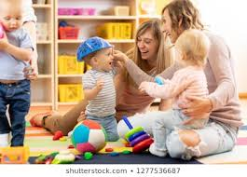
Socializations
Thank you for the collaboration to make socializations happen so quickly – it is truly a team effort!
When we planned for socialization specialists to come on board, we did not know we would be entering the virtual world or go almost a year without socializations, meaning as a group we will be adjusting our calendars to accommodate meetings and socializations!
As this is a new role, all of us will be learning together and figuring out what works and what does not, how much time our Socializations Specialists have and when we are back in person, we will all be adjusting again to provide the best services to our families possible.
One addition to responsibilities, will be all CFS connecting to Remind on the work phone or iPad – this will give you the ability to share the Zoom links with families, whether they have the Remind app or not!

Slide 24
Child Plus
The DRDP (Desired Results Developmental Profile) is a developmental continuum from early infancy to kindergarten entry. It is a formative assessment instrument for young children and their families used to inform instruction and program development.
The DRDP is organized by domains and the domains are aligned with the Head Start Child Development and Early Learning Outcomes Framework (ELOF).
https://www.youtube.com/watch?v=QDKE2G08HvM
For those that want to pilot this program, we will be able to do so for through April 16th. Once the pilot is over the data will be deleted, so you must document in Child Plus also. You will not need to pilot all of your class list, you can do so for one or two children.
I will hold optional Zoom meetings at 9:00 AM every Friday so that we can support each other through this process.

Slide 25
Parking Lot

Slide 26
Slide Show
Thank you!!

