Slide 2
Introductions
Name
Position
County
Gratitude

Slide 3
Survey Monkey follow-up
Larger font
More Small groups
R & H Questions – parking lot in the back, please add any R & H questions you might have, along with any other thoughts or questions you want me to follow up with at the end

Slide 4
Your Journey Together 2.1 A Healthy Climate
Think of a place where you love to shop.
What do you like about the store?
How does the store make you feel?
Think of a place you do NOT like to shop.
What do you dislike about the store?
How does the store make you feel?

Slide 5
The setting you are in impacts your mood and behavior. You are more likely to be friendly in a store you like, while you may be grumpy in a store you do not enjoy.
The same concepts hold true for children. When young children are in places that meet their needs, they are more likely to feel safe, relaxed, and comfortable.
Feeling relaxed, safe and comfortable leads to more learning and positive behavior.
A step further
Go on a tour of your home with your child. Give him a stack of notes and tell him to put one on everything in the house he loves.
How can we apply this to our work and home environments?

Slide 6
NMCAA 2019-20 Program Improvement Plan
Page 3
Recommendation:
Always show up
Go to the visit every week, to support building stronger relationships with the family and build trust that we will always be there
Utilize “Sorry we missed you” or “Wish you well bags” when the family is not home or not feeling well.
Result:
Increased attendance leading to increased School Readiness

Slide 7
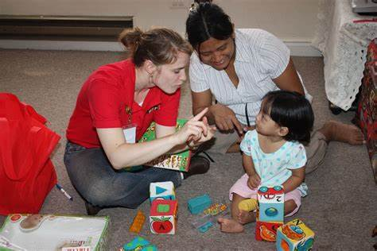
What does this mean for Early Head Start Child Family Specialists?
Find your animal group and think about the following questions:
What supports might you need?
How do we ensure safety?
What might be some obstacles?
How might this be beneficial to our families?
How might it be beneficial to CFS’s?

Slide 8
Month | 2017-18 | 2018-19 | 2019 - 20
September | 73% | 74% | 67% - 73%?
October | 89% | 89% | 91% - 93%
November | 68% | 74% | 71%
December | 54% | 60%
January | 85% | 71%
February | 67% | 70%
March | 70% | 75%
April | 86% | 81%
May | 76% | 85%
June | 81% | 76%
July | 77% | 70%
August | 60% | 79%
Yearly average | 74% | 75% | 76%

Slide 9
 | Complete | Holiday | Bad Weather | No one Home | Staff Cancelled | Family Cancelled | Not Scheduled
September | 73% | 0 | 0 | 3% | 3% | 14% | 12%
October | 93% | 0 | 0 | 2% | 3% | 18% | 3%
November | 71% | 1% | 1% | 4% | 3% | 22% | 3%
December
January
February
March
April
May
June
July
August

Slide 10
Dental Requirement
1302.42(b)(1) Within 90 calendar days after the child receives a home visit, a program must:
(i)Obtain determinations from health care and oral health care professionals as to whether the child is up-to-date on a schedule of age appropriate preventative and primary medical and oral health care, based on: the well-child visits and dental periodicity schedules as prescribed by the Early and Periodic Screening, Diagnosis, and Treatment (EPSDT) program of the Medicaid agency of the stat in which they operate . . .
EPSDT recommends dental referral should start at age 12 months

Slide 11
What is a dental home? In order for EHS to count the dentist as a dental home, the child must have had an appointment with the dentist. If we count a dental home before the child has an appointment; when we complete the PIR and they have not had a dental appointment, it looks like they came in with a dental home and left without a dental home

Slide 12
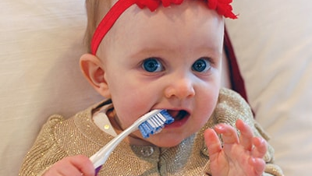
Guidance to support dental health
Talk with families 2 months prior to child’s first birthday to set up a dental appointment or during the enrollment process if the child is already a year old.
If families are reluctant: Complete the dental assessment and curriculum with the family, documenting it as a need in Child Plus.
Work with families to overcome obstacles
Share the families story with the R & H, so they can document in Child Plus

Slide 13
Immunizations
Immunizations – if EHS participants do not have immunizations for HS, they need to meet with the HD and get a waiver so they are not dealing with a late start.
Do you feel comfortable having conversations with families regarding immunizations?

Slide 14
 | Fall | Winter | Spring | Summer
Medical Home | 79%
Health Coverage | 89%
Dental Home | 33%
Hearing Screenings Up to Date | 84%
Vision Screenings Up to Date | 84%

Slide 15
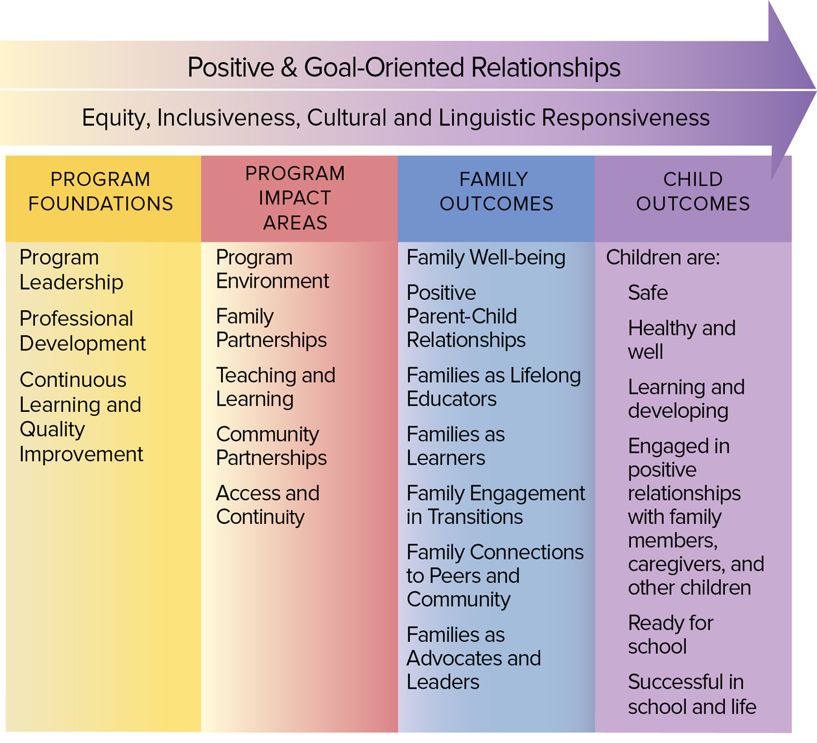
Head Start Parent, Family, and Community Engagement Framework

Slide 16
 | Fall | Winter | Spring | Summer
In Goal Setting Process | 71% | % | %
Active Partnership Agreement | 68% | % | % | %
Need Identified | 78% | % | % | %
Family Partnership

Slide 17
In the end – remember that all the work we do with families is preparing them for school readiness and success!

Slide 18
Demographics
Male 54%
Female 46%
IFSP Status 14%
Birth-1 : 13%
1 – 2 years: 35%
2 – 3 years: 52%

Slide 19
 | % of indicators below expectations |  |  |  | % of indicators at/above expectations
Date | 11/30 | 2/28 | 5/31 | 8/31 | 11/30 | 2/28 | 5/31 | 8/31
Social-Emotional | 14% |  |  |  | 86%
Perceptual, Motor, Physical | 7% |  |  |  | 93%
Approaches to Learning | 8% |  |  |  | 92%
Cognitive | 6% |  |  |  | 94%
Communication, Language and Literacy | 13% |  |  |  | 87%

Slide 20
Focus Area | Fall | Winter | Spring | Summer
Approaches to Learning: 11c -Solves Problems | 94% | % | % | %
Cognitive: 12b – Makes Connections | 96% | % | % | %
Perceptual, Motor, Physical 7a – Uses Fingers and Hands | 93% | % | % | %
Social-Emotional 1c – Takes Care of Own Needs Appropriately | 90% | % | % | %
Communication, Language, Literacy 10a – Engages in Conversation | 80% | % | % | %

Slide 22
Acceptance vs. Enrollment
Acceptance is when a family accepts our program; this is typically done with a phone call and at that time an enrollment visit is set up. Acceptance does NOT count as filling the vacancy, only enrollment fills the vacancy.
Vacancies must be filled within 2 weeks

Slide 23
Enrollment
Enrollment:
This is your first visit with the family and this is the date counted to fill the vacancy left by the previous family, meaning an enrollment visit must be completed within 2 weeks of the drop date of the family they are replacing.
45 day requirements begin on the enrollment date.
Communicating any drops or potential drops with your PSC as soon as you know will support keeping full enrollment.
2 weeks is the maximum time between dropped families and an enrolled families, but Performance Standards state a program must fill any vacancy as soon as possible, meaning there may not be 2 weeks between a dropped family and an enrolled family

Slide 24
Child Development Goals
The goal should be set from milestones, ASQ’s, GOLD, interests of the child
GOLD – look at what the child will be doing next with the parents, what is the child focused on developmentally?
Review goals every week with the parents - is the goal specific enough that you will know if the child has met the goal?
Activities wrap around the goal, the goal does NOT change to match the following week’s activity.

Slide 25
Find your animal group
Share how you support families in setting child development goals.
How can we make them specific enough that we know when they are achieved?
What obstacles do you find in setting family goals?
What questions might you have regarding setting children’s goals?

Slide 26
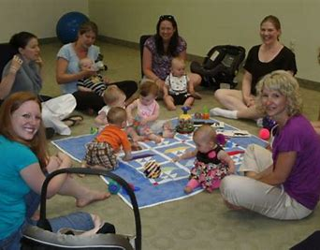
Socialization observations
Socialization observations will be completed in the Winter Quarter (December, January, February) and in the Summer Quarter (June, July, August)
One observation will be completed per county
The questions on the observation are directly correlated to the socialization plan
PSC, EHS Manager, or Coach will complete the observations
Just like the HOVRS and PAT Home Visit Observation Tool this observation will be used to support our practices as a program and will not be used punitively.

Slide 27
Coaches Quarterly Report
Spring 2018-2019:
-19 eligible Child Family Specialists completed the Comprehensive Practice Based Coaching-Professional Development Survey for the 2019-2020 school year.
Summer 2018-2019:
-3 of the 19 eligible Child Family Specialists accepted Comprehensive Practice Based coaching for the 2019-2020 school year.
-16 of the remaining 19 eligible Child Family Specialists set
professional development goals for the 2019-2020 school year.
Fall 2019-2020
Professional Development Goals | 1st Cycle: Shared Goals and Action Planning | 1st Cycle: Reflection and Feedback | Completed 1st Professional Development Goal
Fall 2019-2020 Sept. Oct. Nov. | 16 | 12 | 1

Slide 28
Miscellaneous
In-Kind
How do we collect more in-kind?
We are behind $693,000 per Shannon’s email last week
Child Plus Passwords
PAC meetings – remember if they take place during socializations, we can’t count travel time and mileage a second time

Slide 29
Parking Lot

