Slide 1
Early Head Start 11.9.20
Please add your name, position, and office in the chat box

Slide 2
Introduction and Inclusion
Name
Position
Location
How long you have worked with EHS
Your favorite morning drink

Slide 3
Data – what is it driving?
Our decisions
Our 5 year grant
Program improvement
Our successes !!

Slide 4
5 Year grant
This is an exciting time as we finish the last year of our 5 year grant this fall – it ends December 31
Our new 5 year grant begins January 1 – it has been submitted and waiting approval
Our School Readiness Goals will be aligned birth to 5 along all program options – again all goals for the program and for our School Readiness came from the data we collect each quarter The 5 year goals will support growth in all developmental areas and the actions will support reaching the goals – not much different than what you do with all your families!
I will be sharing our 5 year grant at our next Early Head Start meeting

Slide 5
Attendance . . . over the years
 | 2017-18 | 2018-19 | 2019 – 20 | 20-21
September | 73% | 74% | 67% | 79% 220/245 families enrolled 88%
October | 89% | 89% | 91% | 71% 221/245 families enrolled 80%
November | 68% | 74% | 71%
December | 54% | 60% | 63%
January | 85% | 71% | 84%
February | 67% | 70% | 73%
March | 70% | 75% | COVID
April | 86% | 81% | COVID
May | 76% | 85% | COVID
June | 81% | 76% | COVID
July | 77% | 70% | COVID
August | 60% | 79% | COVID
Yearly average | 74% | 75% | 75%

Slide 6
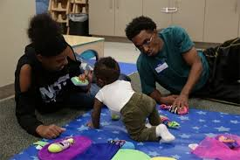
Attendance 2020-21
 | In person | Virtual | Phone | Family Cancelled | Not Scheduled | Staff Cancelled | Bad Weather | Holiday | COVID | No one home
September 220 enrolled | 25% | 43% | 11% | 17% | 2% | 1% | 0 | 0 | ½% | 1%
October 221 enrolled | 28% | 38% | 6% | 21% | 4% | 1% | 0 | 0 | 0 | 2%

Slide 7
Small group: 10 minutes Please elect a spokesperson for large group
What successes have you had with attendance?
What obstacles keep you from “Always showing up?”
How has visiting virtual impacted attendance – positively and negatively?

Slide 8
Large Group
Successes
Obstacles
Virtual
Other thoughts

Slide 9
Break 10 minutes and Poll Question - PAT materials

Slide 10
Health
Health | Fall 2019 | Fall 2020
Enrolled families who have a Medical home | 79% | 81%
Enrolled families who have Health Coverage | 89% | 93%
Enrolled families who have a Dental Home | 33% | 31%
Auditory screenings up to date | 84% | 87%
Vision screenings up to date | 84% | 87%

Slide 11
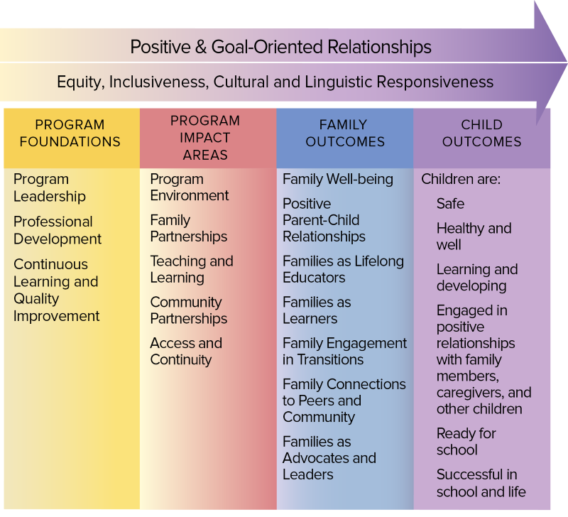
Family Engagement
Family Engagement | Fall 2019 | Fall 2020
In a Goal Setting Process | 71% | 70%
Active Family Partnership Agreement | 68% | 75%
Need Identified | 79% | 81%

Slide 12
Disabilities
Disabilities | Fall 2019 | Fall 2020
Enrolled Children with an IFSP/IEP | 17% | 15%

Slide 13
EHS Monthly Home Visit Follow-Up/In-Kind Tracking * This top portion of In Kind must be completed monthly for each family and sent to your R & H- they can be CC’ed when you send to Chris Welton
Child’s Name _____________________________________Month/Year:___________________ Dual Enrolled Y N
Health Medical Insurance: Yes or No Insurance Recert. Date__________ Follow Up:______________________________ WIC___________ Lead_______________ Hemoglobin__________ WBC____________ Dental __________ Notes:
Screenings (due within 45 days) Vision: ASQ: Hearing: eDeca (& annually) | Nutrition and Safety:
Family Engagement Family Goal: Supports requested: Next Review (within 30 days): Other Service Provider Updates: Socialization Ideas: Policy Council/Parent Advisory Committee

Slide 14
Eligibility
 | Foster Child | Homeless | Income Below 100% | Income 100<130% | Over Income | Public Assistance
Fall 2019 | 5% | 12% | 55% | 11% | 8% | 9%
Fall 2020 | 4% | 10% | 50% | 13% | 9% | 13%

Slide 15
Small Group – 15 minutes
How to we continue to support families in getting the following completed?
Medical/Dental Home
Health Insurance
Vision/Hearing Screenings
Setting Family Goals
Completing their Family Partnership Agreement
As home visitors how can we ensure dental and medical information is getting to R & H’s?
How can we ensure we have enough eligible families on our wait list?
Elect a speaker for large group

Slide 16
Innovative Ideas

Slide 17
Socialization Specialist Update Interviews were conducted last Wednesday
Southern Socialization Specialist
Roscommon
Missaukee
Wexford
Benzie
Leelanau
Northern Socialization Specialist
Grand Traverse
Kalkaska
Antrim
Charlevoix
Emmet

Slide 18
CFS Socialization Responsibilities
CFS worked with Marissa to complete this form
This is an attempt to ensure all responsibilities are covered, although socializations are the SS’s primary responsibility – they will need support from CFS’s
Knowing this is a new position, responsibilities and forms will change to best support the socialization process.

Slide 19
CFS Responsibilities
Quarterly County CFS Team meeting with the Socialization Specialist
Be at Socialization 30 minutes prior and plan to stay 30 minutes post to ensure the socialization is well organized and discuss what went well and what might need improvement is discussed. The SS will not have keys to all sites.
If the designated CFS is not able to be at the Socialization, it is their responsibility to find a staff member to replace them
Deep cleaning and switching out toys will continue to be the CFS team responsibility
CFS’s will continue to discuss Socialization ideas monthly with families and share information with the SS

Slide 20
Socialization Specialist Responsibilities
Reviewing County GOLD data
Planning the Socialization (with CFS and family input)
Menu Planning
Grocery Shopping
Calendar and Newsletter
Parent Advisory Committees/Policy Council Updates
Attach Sign In sheets to CP

Slide 21
Beginning collaboration!
Each County Team will have a Virtual introduction meeting with their Socialization Specialist within the next few months. At this meeting the SS and CFS County Team will complete the Socialization and CFS Introduction form
Discuss and set dates for the next 3 months of socializations
Schedule what CFS will be attending each scheduled county socializations
Discuss who your county team may collaborate with for socializations
Discuss most recent Quarterly Gold Data
Remind Platform
Schedule the next 3-month County Socialization Recap
Any other important information

Slide 22
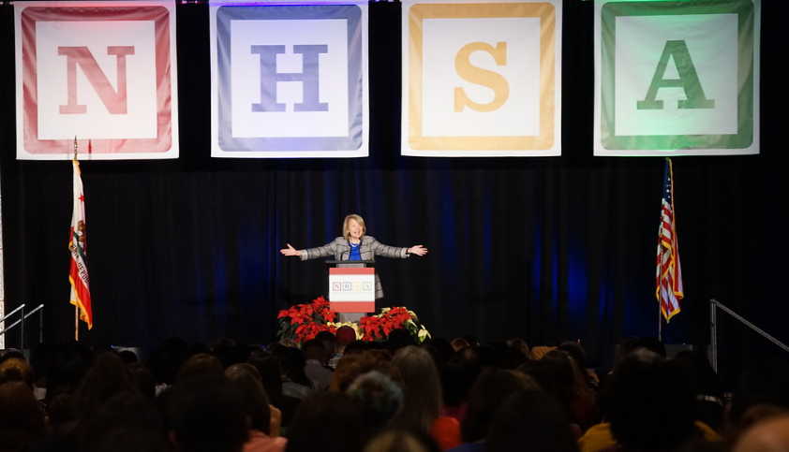
PFCE Conference December 1-3: 11:00-4:30
MHSA’s 38th annual Parent and Family Engagement Conference is the only national event that focuses on how Head Start parents, families, and staff can best partner to promote both family engagement and children’s development.
A variety of sessions and presenters will enable conference attendees to indulge in discussions designed for parents, staff and leadership. Learn about developmentally appropriate innovations that are a practitioner- and family-friendly. Experts will share techniques and skills you can take home to create safe environments in which children can learn and flourish.
https://mynhsa.force.com/nhsacommunity/s/lt-event?id=a4u3w0000011CroAAE#Agenda
If you are interested in attending this conference, please write your name in the chat box

Slide 23
Lunch! Polling question:
45 minutes

Slide 24
Family Outcomes Tool – Large group
What are the successes?
What are the obstacles?
What tricks have you learned?

Slide 25
Parent Satisfaction Surveys
file:///C:/Users/cberden/Desktop/2019-2020%20Survey%20Results%20-%20Google%20Slides.html

Slide 26
Parking Lot

