Slide 1
EHS Academy
Language and Communication: Every moment is a learning moment

Slide 2
We hope you leave here with a. . .
Greater understanding of ELOF
New insight into family culture and background
Better guidance for Parenting Behaviors and Parent Interactions
Support for virtual home visits.

Slide 3
Agenda 1:00-3:00 PM
1:00-1:15: Introductions
1:15-1:30: Elof and TSGOld
1:30-2:00: Family Culture and Background Knowledge
2:00-2:30: PAT Practices
2:30-3:00: Virtual Visit Conversation

Slide 4
Introductions
Tell us. . .
1. Your name
2. Your office location
3. What app do you use the most on your phone?

Slide 5
ELOF & TSGold
Early Learning outcome framework & teaching strategies gold

Slide 6
What is ELOF Early Learning Outcome Framework
The Head Start Early Learning Outcomes Framework: Ages Birth to Five describes the skills, behaviors, and knowledge that programs must foster in all children.
The Framework is grounded in a comprehensive body of research about what young children should know and be able to do to succeed in school. It describes how children progress across key areas of learning and development and specifies learning outcomes in these areas.
This information will help adults better understand what they should be doing to provide effective learning experiences that support important early learning outcomes.
Notes:
Pat and gold align with ELOF
Our starting off point.
Ground work of ELOF

Slide 7
Early Learning Outcome Framework (ELOF)
Language development refers to emerging abilities in listening and understanding (receptive language) and in using language (expressive language).
https://eclkc.ohs.acf.hhs.gov/interactive-head-start-early-learning-outcomes-framework-ages-birth-five

Slide 8
Words You Can Use. . .
Communication is sharing thoughts, feelings, or ideas between two or more people.
Expressive language is the ability to communicate with others through gestures, speaking, or writing.
Language is the ability to both use and understand spoken words or signs. Language is all about ideas passing from one person to another.
Literacy is the ability to use and understand written words, or other symbols, in order to communicate.
Receptive language is the act of attending, listening to, and comprehending language.
Vocabulary refers to all of the words a person knows.
https://eclkc.ohs.acf.hhs.gov/school-readiness/article/news-you-can-use-foundations-school-readiness-language-literacy#toc05

Slide 9
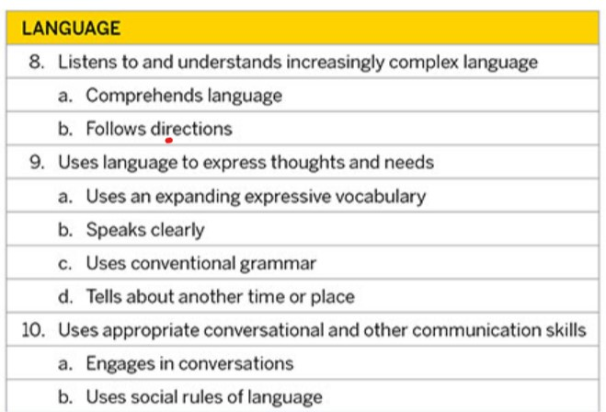
Teaching Strategies Gold
Language Objectives
Notes:
These are the objected we are familiar with using when helping us understand where our enrolled children fall in their developmental continuum.

Slide 10
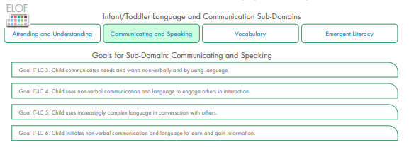
ELOF: Language & Literacy
1) Attending and Understanding
2) Communicating and Speaking
3) Vocabulary

Slide 11
Connecting ELOF and TSGOLD
ELOF Attending and Understanding. | TSGOLD
Goal IT-LC 1. Child attends to, understands and responds to communication and language from others. | 8a. Comprehends language
ELOF Goal IT-LC 2. Child learns from communication and language experiences with others | 8b. follow direction 10a.Enages in conversation. 10b. Uses social rules of language.
ELOF Communicating and Speaking | TSGOLD
Goal IT-LC 3. Child communicates needs and wants non-verbally and by using language | 9a. Uses an expanding expressive vocabulary.
Goal IT-LC 4. Child uses non-verbal communication and language to engage others in interaction | 9c. Uses conventional grammar 10a. Uses appropriate conversational and other communication skills. Engages in Conversation.
Goal IT-LC 5. Child uses increasingly complex language in a conversation with others. | 10a. Engages in conversation
Goal IT-LC 6. Child initiates non-verbal communication and language to learn and gain information. | 10a.Engages in conversation
ELOF Vocabulary | TSGOLD
Goal IT-LC 7. Child understands an increasing number of words used in communication with others. | 9a. Uses and expanding expressive vocabulary
Goals IT-LC 8. Child uses an increasing number of words in communication and conversation with others. | 10a. Uses appropriate conversational and other communication skills. Engages in Conversation. 10b. Uses social rules of language. 9b. Speaks clearly 9d. Tells about another time or place

Slide 12
Family Culture& Background

Slide 13
Culture
“Culture is shared among members of a community and passed along from generation to generation. Culture is a set of invisible rules, values, and beliefs that we learn to think of as normal.”
“Parents may not even realize that they have created a home culture. They may not give any thought to the everyday ways they feed, dress, bathe, and care for their children. For all of us, the specifics of our home culture can be invisible. It is sometimes difficult to recognize exactly what we value and prefer until we encounter another way.”
PAT I-29
Notes:
Culture is often thought of defined by the first quote, but we are going to look closer that the second quote where we focus on individual, family culture. We all know that individualy family culture is greatly influenced by the community and generational culture.
Today we are going to be specifically looking at individual family culture. With that being said, we know that family culture is greatly influenced by race, ethnicity, national origin, color, gender, geographic location, religion, etc. We know that all of these components and more play a role in how the individual family culture is created.

Slide 14
Cultural expectations can influence adult-child interactions in many ways. For example, in some cultures, children are taught to show respect to adults by making direct eye contact when spoken to. In other cultures, children are taught that respect is demonstrated by avoiding direct eye contact.
https://eclkc.ohs.acf.hhs.gov/interactive-head-start-early-learning-outcomes-framework-ages-birth-five
Type in the chat box or unmute yourself if you have an example of family culture.
Notes:
This is a larger community culture. Let’s think about family culture. My example is (water drinking). Family culture often includes the rituals, rules, expectations in a home setting.

Slide 15
Background Knowledge
Background knowledge is the information that children learn and store in their memories—including information about themselves, other people, objects, and the world around them. This includes the beliefs, values, rules, and expectations in children’s cultures, environments, and languages. Even very young children begin to understand the routines of their lives and the words people say to them. They learn when and how to eat, play, walk, run.
Children use this background knowledge as they begin to talk, write, and use books and other print materials. Children learn and gather more and more information as they interact with people and their environments. Over time they develop a deep understanding of the routines of their lives and the words people say to them.
https://eclkc.ohs.acf.hhs.gov/sites/default/files/pdf/no-search/dtl-pla-background-knowledge.pdf
Notes:
Example of background knowledge of a family: We have friends that are obsessed with hunting. They post pictures on facebook of their 5 year old son pretend duck hunting in the yard. He has all his stuff animals spread out, he creates hunting blinds out of pillows. It’s a big part of their family culture, mom and dad both hunt, they make jerky from it. It becomes part of their meals, and daily lives.

Slide 16
Young children gain background knowledge as they:
Connect new information to knowledge they have in memory
Understand and gain new knowledge through observations, interactions, and instruction
Solve problems and figure out how objects and their world work
Expand their use of language and develop new vocabulary
Reflect on what they know
Notes:
Example of boy loving to play with cars or a family really like to hunt. The one child may have extensive knowledge about hammers, wrenches. Engines. And the other might have extensive knowledge about deer, trees, plants.
Examples of background knowledge.

Slide 17
The Big 5
1. Background Knowledge 2. Oral Language & Vocabulary 3. Book Knowledge & Print Concepts 4. Phonological Awareness 5. Alphabet Knowledge & Early Writing.
The Big 5 come from the PLAN Learning Approach (PLA). The PLA is a comprehensive, systemic, research-based way for Head Start, Early Head Start, and childcare programs to ensure optimal language and literacy services for children who speak English and who are dual language learners (DLLs).

Slide 18
Background Knowledge

Slide 19
Background knowledge meets Book knowledge and Print Concept

Slide 20
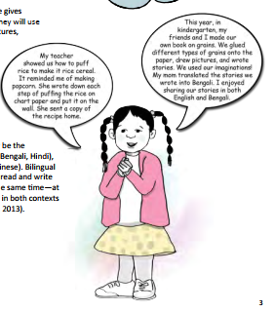
Background Knowledge meets Alphabet Knowledge and Early Writing
Notes:
WE could incorporate rice into a PAT activity with meal prepping.

Slide 21
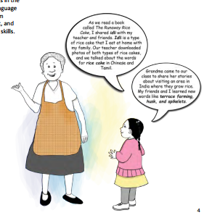
Background Knowledge Meets Oral Language and Vocabulary
Notes:
This story shows how the teachers took the culture and background of the child (what she knew ) to help her learn more about new concepts. It’s a starting off point of familiarity to help advance a child’s development.
Any thoughts about this resource?

Slide 22
Culture and Background Knowledge
Think about the definitions of culture and background knowledge. How would you connect these two concepts together?
Culture is Culture is shared among members of a community and passed along from generation to generation. Culture is a set of invisible rules, values, and beliefs that we learn to think of as normal.
Background knowledge is the information that children learn and store in their memories—including information about themselves, other people, objects, and the world around them.
Notes:
We are individualizing the developmental activities(language & communication) to the child’s experiences (background) and what they know to be true(culture) to enhance their learning.
Is taking all the information the child knows about their way of life, what’s important to that child’s family and use that information to make that child successful in all areas of development.

Slide 23
Research Perspectives on Culture and Child Development
The cultural rules children learn at home may be very different from the ones they are expected to know when thy enter a childcare center or school (Fleer, 2002;Keyser, 2006).
If adults (parent educators, teachers, and caregivers) don’t understand the cultural rules and norms of the child’s family, we may misread a child’s developmental progress, aptitude, and abilities (Bowman & Stott, 1994).
Notes:
What do you think of these statements?

Slide 24
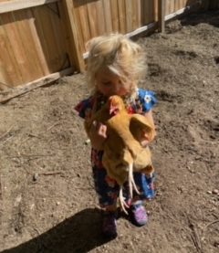
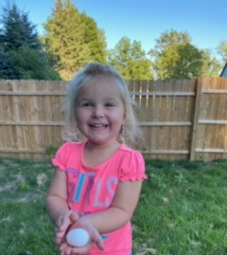
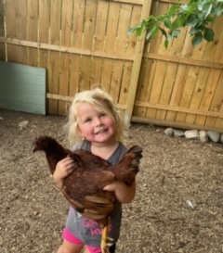
Group Break Out (10 minutes) How would you incorporate our family culture into a home visit or into language and literacy activity? Talk about a time when you have been able to incorporate a family’s culture into their home visit.
Notes:
10 minutes and find a speaker to share in large group
Groups of 3

Slide 25
PAT Practices
Parenting Behaviors and parent-Child interactions

Slide 26
Top 3 Chosen Practices for the 2020-2021 Professional Development Program Year:
 | Top 3 Chosen Practices for the 2020-2021 Professional Development Program Year:
1. | During language and literacy activities, I facilitate one or more parenting behaviors; Nurturing, Designing/guiding, Responding, Communicating, Supporting Learning (PAT #12)
2. | I connected around a conversation from the previous visit that was focused around language and literacy. (PAT #9)
3. | During language and literacy activities, I encourage or reinforce and prompt positive parent-child interactions. (HOVRS #5.7)

Slide 27
5 Parenting Behaviors
Nurturing
Designing/Guiding
Responding
Communicating
Supporting learning
“Consistency in recognizing, acknowledging, encouraging these behaviors in parents is at the base of parent educator support.” Parent Educator Resource page 501.
These are parenting behaviors for which there is a solid evidence base demonstrating the impact they have on positive outcomes for children.

Slide 28
What is the parent educator's role in parenting behaviors?
Observe the parents’ behavior in response to and in interactions with their child.
Note and share with parents their strengths.
Make connections with the parent’s behavior and the child’s developmental level.
Partner with parents to identify and develop parenting strategies that are consistent with their family values and culture.
Encourage parents to reflect on the source of their parenting behaviors and values and set goals for growth.
Facilitate opportunities for parents to practice specific parenting behaviors.

Slide 29
Connecting Parenting Behaviors to a Child’s Development.
Notes:
What does that do for a parent/caregiver when we are able to identify their positive behaviors?
-In my follow up email, will provide a cheat sheet to show you how to put the statement together.

Slide 30
Let’s practice!
How can you provide a parenting behavior response to this parent pertaining to language development?
When you . . . | Your child. . .
Notes:
One verbal example and one chat box.

Slide 31
During language and literacy activities, I encourage or reinforce and prompt positive parent-child interactions. (HOVRS #5.7)

Slide 32
3 types of parent-child interactions.
Personal Care is when you feed, bathe, and dress your child. You are taking care of his needs.
Assisted learning is when you teach your child how to do something or engage him in an educational activity. When adults are initiating or leading the interaction.
Connecting is when the child leads the play and the adults follow, allowing the child to initiate whatever type of play interests her.
Notes:
The practice we are looking at comes from HOVRS but the resources I used to explain positive parenting child interactions all came from PAT

Slide 33
Strategies for facilitating parent-child interactions.
Keep the “action” between the parent and their child by handing the materials directly to the parents rather than to the child
This keeps parent in the role of the teacher and you in the role as the consultant.
Handing materials to parent also sends the message to the child that parents –not-you-provide the fun, stimulating activities. This action repeated many times, established parent-child interaction as the context for fun and learning.
“Say what you see” and “ask what you don’t see” is a strategy that puts you in the role of consultant and partner.
By pointing out what you see in parent-child interactions, you help parents and caregivers become more aware of their interactions with their child. This strengthens their ability to observe and reflect on their actions and those of their child. Sticking to observations prevents your from making assumptions and keeps the focus on the parents and the child.
Ask questions rather than assume.
Instead of assuming Jason doesn’t count blocks because you haven’t witnessed it, ask the question, “I noticed Jason picked up three blocks. Does he ever count blocks or other objects?”
Asking questions can prompt parents to think in a different way or try something new.
If the parent and child feel successful in their interaction, there are more likely to repeat it.
Home visitor = Consultant
Parent = Teacher

Slide 34
Let’s Discuss!
How would you encourage parent child interactions?
How could you ask questions rather than assume?
Say what you see and ask what you don’t see.
Notes:
How do you fill that space? Explain parenting behaviors rather than engaging with child in play.

Slide 35
Virtual Visits
How to meaningfully connect through a virtual platform

Slide 36
Brainstorm Breakout
Discuss with your group, 1 struggle you may have had with virtual visits and work with your group to find one solution/alternative to improve upon the process.
or
Discuss with your group how to improve on implementing parenting behaviors an/or parent-child interactions with your families through a virtual format.
15 mins. Pick a speaker to summarize for large group.
Notes:
Two groups of 4 and one group of 3

Slide 37
Thank you!
Please complete Survey Monkey.

