Slide 1
Google Drive Set Up Agenda
Do you have an account?
Set up account
How to access the account
DISCLAMER: I am still learning & I am self taught ☺
What is Google Drive?

Slide 2
What is Google Drive?
Google Drive is a cloud-based storage solution that allows you to save files and folders online and access them anywhere from any smartphone, tablet, or computer.
You can use Drive on your computer or mobile device to securely upload files and edit them online.

Slide 3
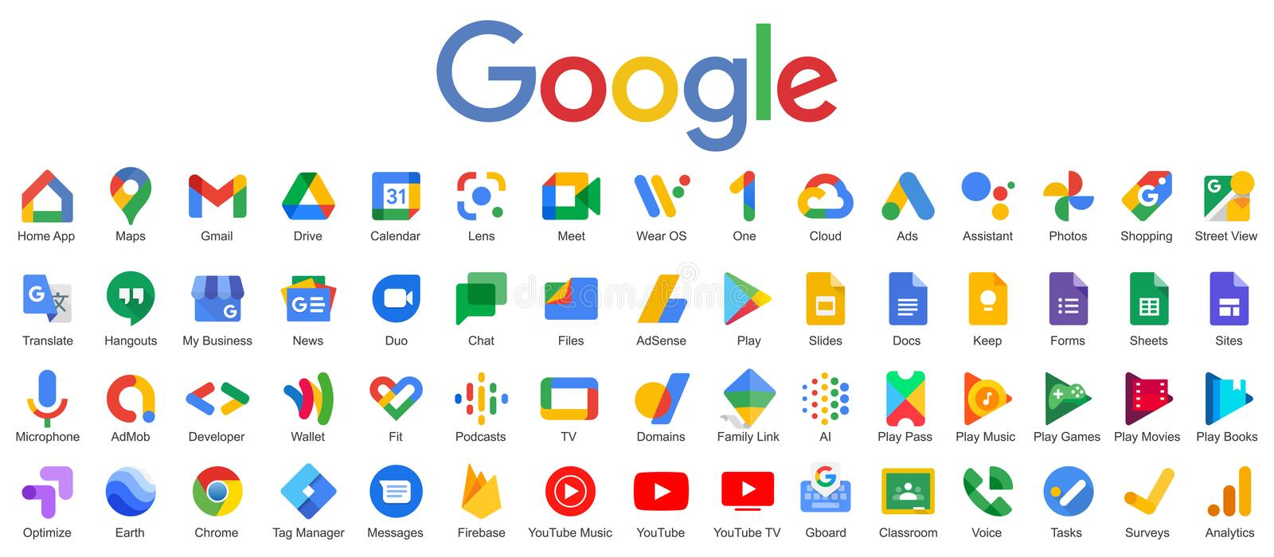
You may have an account if you have used any of these and others

Slide 4
You can use your personal email or work email.
Click to create google account/sign in
Using existing email
Click Create account.
Enter your name.
Click Use my current email address instead.
Enter your current email address.
Click Next.
Verify your email address with the code sent to your existing email.
Click Verify.
Creating Gmail email
Click Create account.
Enter your name.
In the "Username" field, enter a username.
Enter and confirm your password.
Click Next.
Optional: Add and verify a phone number for your account.
Click Next

Slide 5
How to access Google Drive Now that I have an Account Set up?
Fire Fox: put link in URL https://drive.google.com/
Google Chrome: https://drive.google.com/ or click waffle icon
Microsoft Edge: https://drive.google.com/

Slide 6
Thank you!!
Please let me know if you have any questions. You can call, text, or email
231.330.2895 or triley@nmcaa.net
Learn Google Drive tips at the next session on Thursday 11a-12p

