Slide 1
Coaching Implementation

Slide 2
Agenda
Why?
Review Form: EHS PBC Needs Assessment 21-22
Review Form: EHS PBC PD Survey Priority Criteria
Discussion

Slide 3
Why did we create a Coaching Implementation Team?
Corey and I completed the Practice Based Coaching Screener Needs Assessment-
The Practice-Based Coaching (PBC) Implementation Screener Needs Assessment is a list of questions and indicators related to the effective implementation of PBC. This screener was developed for a program’s PBC Implementation Team to use as they review their current and future implementation of PBC. This screener allows a program to identify their current strengths as well as areas of need to guide planning for continued improvement of PBC implementation.
Best Practice
Notes:
Tammy Funnel went through this form with us as the Training and technical assistance specialist. She supports us in continual program improvement.

Slide 4
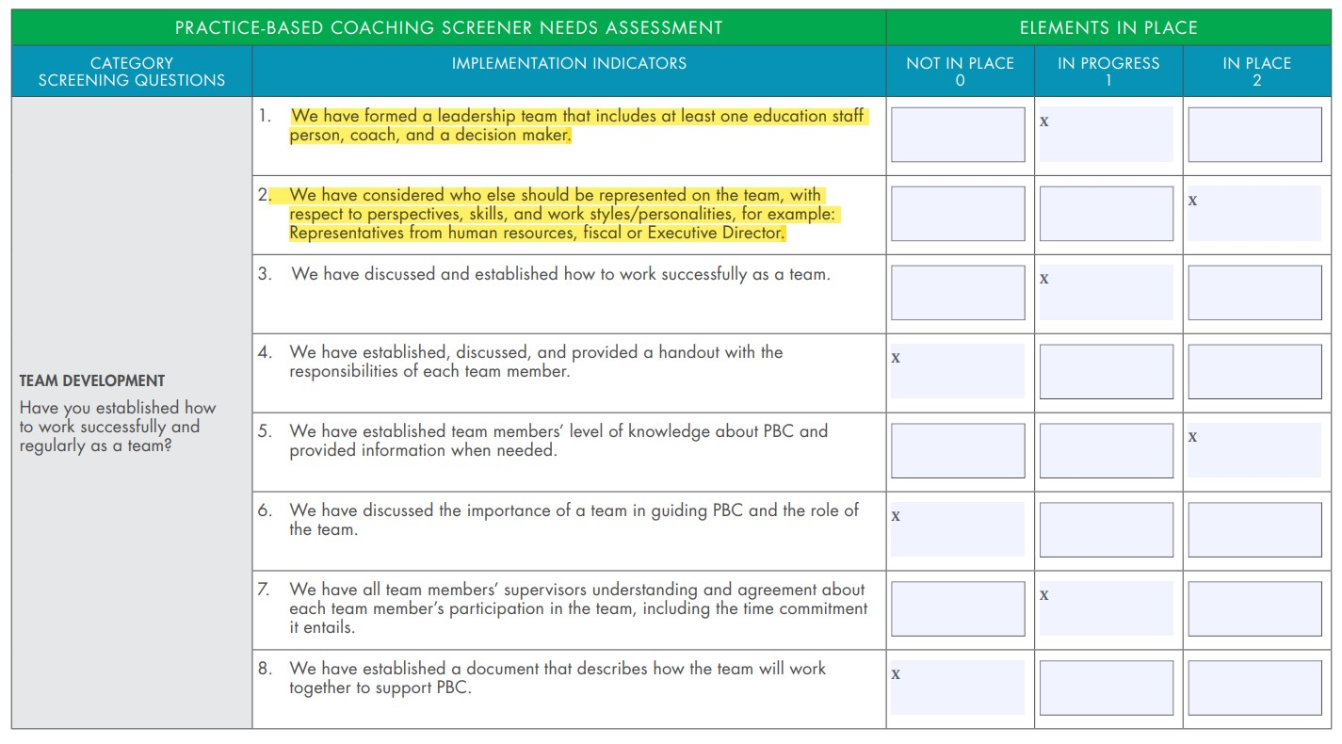
Area of Growth from PBC Screener Assessment

Slide 5
Form: EHS PBC Needs Assessment 21-22
https://www.nmcaaehs.com/uploads/2/4/0/2/24026312/ehs_pbc__needs__assessment_21-22docx.docx

Slide 6
Form: EHS PBC PD Survey Priority Criteria
https://www.nmcaaehs.com/uploads/2/4/0/2/24026312/ehs_pbc_priority_points.docx

Slide 7
Set a date to meet again.
Notes:
Up for discussion within 3-6 months to complete responsibility form and review 1-2 forms every couple months.
Quarterly data

Slide 8
Any questions?

